Slide 1
SPIA Small Grants
Measuring CGIAR’s Policy Influence
Informational Webinar for Prospective Applicants
  16 July 2026
  Presenters:
  - Monica Biradavolu (Panel Member)
  - Swetha Ramachandran (UoE Senior Officer)

Slide 2
Agenda
01 Welcome and Context
02 About the Call and Candidate Cases
03 Eligibility and What We’re Looking For
04 Mentorship and Learning Opportunities
05 Timelines
06 How to Apply and FAQs

Slide 3
About This Call
      Why this call exists
CGIAR’s policy influence (as with most research organizations) is notoriously hard to trace: research and evidence are produced, uptake by policy actors is sporadic, policies are formulated and gazetted, and implementation plays out unevenly on the ground. SPIA has shortlisted six candidate cases to critically examine these pathways: not to only collect success stories.
      Two broad pathways: either or both
  a) CGIAR input → policy output: did CGIAR contribute, how, and how did the political economy shape evidence uptake?
  b) Policy output → downstream impact: has the change sustained over time, and what has it generated, for whom?

Slide 4
Six Candidate Cases
Applicants select ONE case only ; proposed questions are suggestions only
Case | CGIAR center involved | Country / Region | Theme
A. ECOFISH & Hilsa Conservation | ECOFISH | Bangladesh | Fisheries policy reform
B. Tax Exemption for Ag. Technologies | IWMI | Ethiopia | Taxation & ag technologies
C. Productive Safety Net Programme | IFPRI | Ethiopia | Social protection
D. Bamboo Strategy & Action Plan | CIFOR | Uganda | Forestry & restoration
E. Aflatoxin Policy & Control | IITA | Uganda / EAC region | Food safety
F. Longitudinal Engagement with MARD | Multiple | Vietnam | Institutional engagement (25 yrs)

Slide 5
Who Should Apply
      You’re a good fit if you…
  Are a PhD student / postdoc / early-career researcher in political science, sociology, development studies, public policy or public administration
  Are interested in the political economy of agricultural development and/or public policy
  Can design and run a small-scale research study independently, with minimal supervision
  Have prior experience with sensitive KIIs: government officials, scientists, farmers, agro-dealers, development stakeholders
  Have a methodological niche (qualitative and/or quantitative) and enjoy a complex problem
  Understand what rigorous policy research entails
  Can write for both academic and policy audiences

Slide 6
What We Especially Value: Beyond the Checklist
      Strong methods, grounded experience
  Real depth in your chosen method (qualitative and/or quantitative) applied rigorously, not just familiarity with it
  In-country and case-specific experience: knowledge of the sector, the actors, and the political economy of the case you choose
  Able to work independently, attuned to contextual and institutional sensitivities
      A priority: nationally based researchers
  We encourage applications from researchers based in the case study countries (or for applicants to consider partnering with them).This is not a mandatory requirement, but encouraged

Slide 7
What Makes a Strong Proposal
      Keep it focused
  One case only ; multiple submissions won’t be considered
  Sharp, policy-focused research question(s)
  Manageable scope for the budget and timeline; pilot/exploratory designs are strongly encouraged
  Honest about null results: a stalled reform or a claim that doesn’t hold up is a valid finding
      Go beyond the paper trail
  Distinguish policy on paper from policy as lived experience
  Explore mechanisms of influence, political economy, and who bears the implementation cost
  Lean on qualitative methods, as appropriate
  SPIA can help connect you to CGIAR stakeholders for KIIs/FGDs; you drive the relationship from there

Slide 8
How We Will Enable You
      Matchmaking with a mentor
  Each selected applicant will be matched with a mentor based in the case country
  The mentor will:
    Help the applicant sharpen their research question, scope, data collection etc.
    Help maneuver institutional and political sensitivities
    Facilitate introductions with in-country policy actors
    Provide periodic feedback on your research
    Assist in obtaining any in-country approvals/permissions (if applicable)
      Learning opportunities
  Virtual workshops during the grant period to present your ongoing project and receive feedback from peers and other mentors
  Opportunity to participate in and learn from the SPIA community of practice (COP)
  Opportunity to present findings to wider CGIAR / policy audiences at the end of the grant period
  Publish knowledge products in SPIA outlets (blogs, learnings, reflections)

Slide 9
Key Dates
Milestone | Date
Call opens | 06 July 2026
Informational webinar (today) | 16 July 2026
Submission deadline | 07 August 2026, 23:59 CEST
Review & decisions | Mid – late August 2026
Contracts signed | Early September 2026
Research period | September – December 2026
Final report due | End of January 2027

Slide 10
How to Apply
      Technical proposal (≤3 pages, excl. CV)
  Selected case, research question(s), and rationale / value-add
  Proposed design and methods
  Sources, access, and feasibility / risks
  Workplan and timeline, plus a 2-page CV and proof of enrollment or employment
      Budget (1 page or a simple table)
  Fieldwork/travel, interviews & data collection, and researcher time
      Send both to spia@cgiar.org by 07 August 2026, 23:59 CEST

Slide 11
FAQs
      1) Can current researchers from CGIAR centers apply? Yes, if you meet eligibility AND applicants need to be reflexive about independence. Applications with clear conflict of interest (for ex. you work for IRRI and plan to study a case related to IRRI) will not be accepted
      2) Can multiple applicants submit one proposal? Yes, but atleast one applicant must meet eligibility criteria
      3) Can I apply as an independent researcher without university/institutional affiliation? This can be permitted, please write to spia@cgiar.org explaining your specific situation and we will revert
      4) Will SPIA support with ethical clearances? Clearances on 2 levels: a) IRB/ethics clearance and b) In-country approvals and permissions. SPIA team and mentors can support both, but documentation and heavy-lifting to be led by the applicant
      5) Will SPIA help me connect with stakeholders? Yes, SPIA and the mentors will facilitate relevant introductions (with CGIAR centers, project staff, national and sub-national ministry stakeholders, development actors, and others)
      6) What type of ‘final output’ is anticipated? A final report is mandatory. Follow-up journal articles, policy pieces etc. may be pursued in consultation with SPIA.
      7) Can I publish in other public domains and/or can the research be a part of my PhD dissertation? This will be determined on a case-by-case basis.
      8) Can I use AI to facilitate my research? Yes, but in line with SPIA policies and principles.

Slide 12
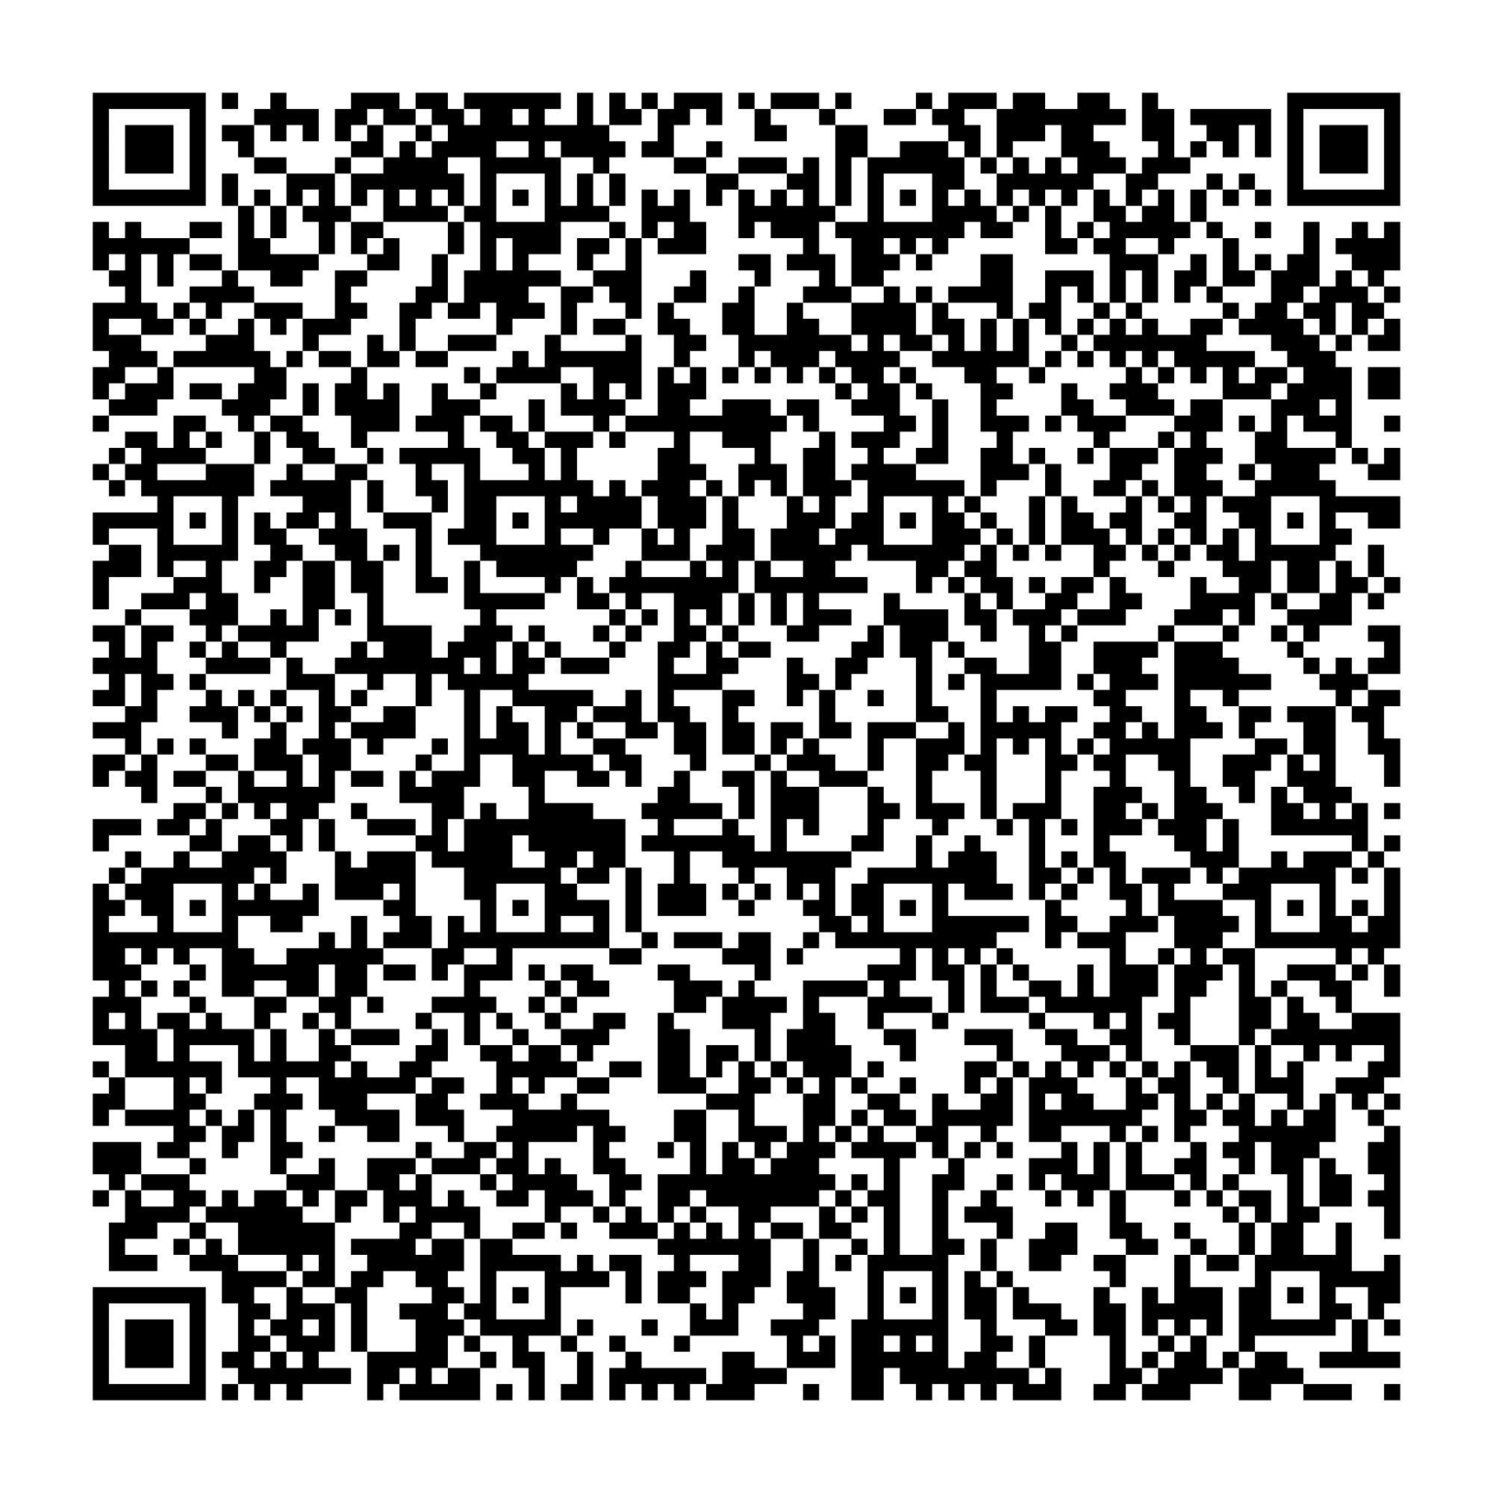
Questions?
Sign up here for SPIA updates

