Slide 1
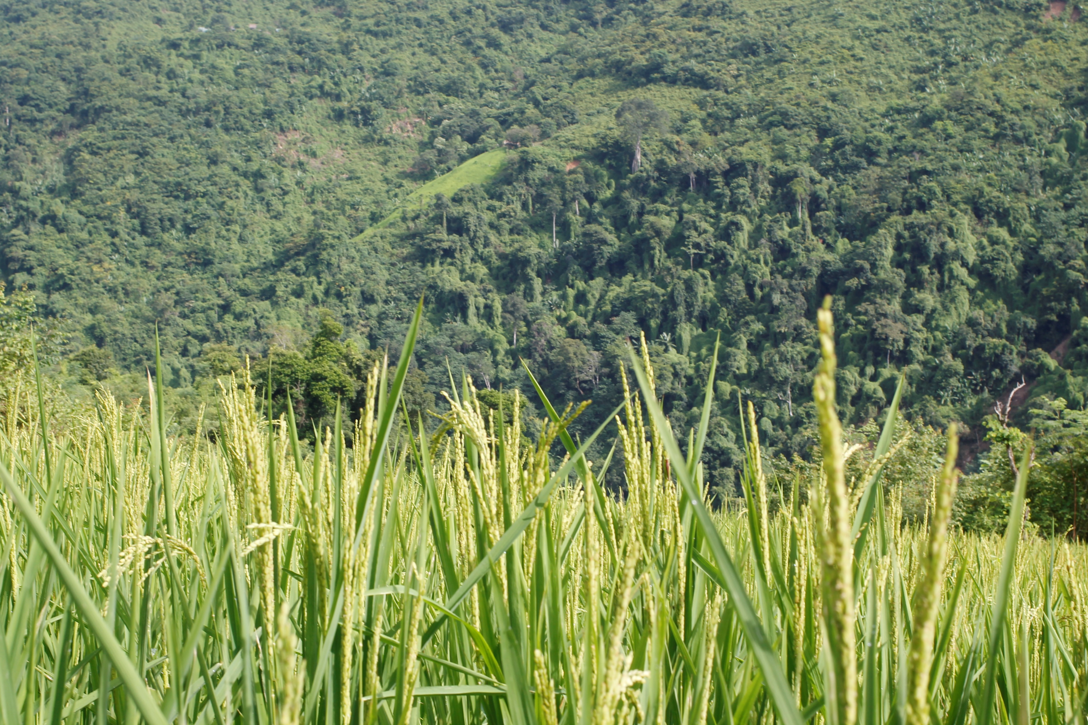

Finding the right words
Using mixed methods to measure adoption of the “1 Must-do, 5 Reductions” rice cultivation package in Viet Nam
Monica Biradavolu (QualAnalytics & SPIA) &
Sujata Visaria (City St. George’s, University of London & SPIA)
Joint work with Thao Bach (UC Davis), Frederic Kosmowski (SPIA), Phuong Thi Minh Nguyen (ILRI), James Stevenson (SPIA)
Photo: G. Smith/The Alliance
SPIA Webinar, 15 April 2026

Slide 2
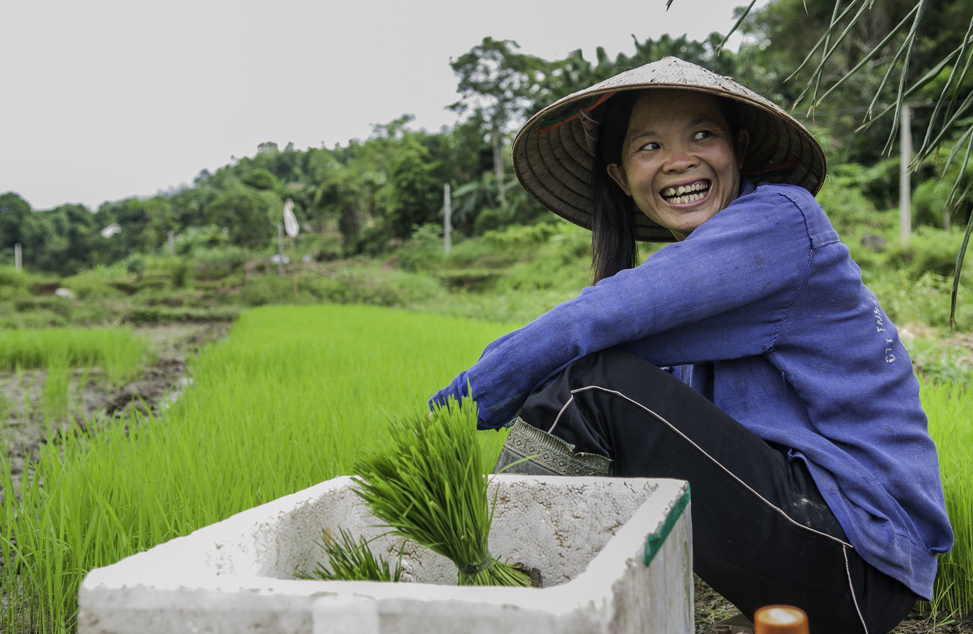
Our setting
In Vietnam, SPIA attempted rigorous measurement of the adoption of CGIAR’s innovations…
…through questions added to a nationally representative household survey (VHLSS).
One Must Do, 5 Reductions (1M5R)
bundle of recommendations for low-land rice cultivation
Notes:
Sujata
From 2019 to 2024, SPIA was directly involved in 4 country studies, in ETH, UGA, VN and BD. We attempted to rigorously measure the adoption of CGIAR innovations in these countries at the national level. This was done in VN by adding new questions to the Vietnamese official household survey – Vietnam Household Living Standards Survey (or VHLSS) in 2022, 2023 and 2024.
In this presentation, we will discuss the challenges that we faced and how we dealt with them – with respect to one particular innovation – which is called “1 Must Do 5 Reductions”. a bundle of recommendations for sustainable cultivation of rice.

Slide 3
Measuring adoption of a CGIAR innovation
Action is consistent with recommendation
Action is due to recommendation
Farmer has adopted innovation
Challenge: Construct validity
Does survey instrument measure what it intends to measure?
Challenge: Attribution
If there is no comparison group, how can a survey capture the necessary information to attribute change in behavior to the program?
Notes:
Sujata
Explain how we thought about “adoption of the CG innovation” – actions that farmers take should be consistent with the recommendations + they should be taking that action because of the recommendation.
But with first, challenge is how to accurately measure farmers’ actions through a survey where they report what they did – how does one frame the question so that it captures what we need to know?
With the second, even if they are acting in line with the recommendation, how do we know what caused them to do this – esp. in a setting where there is no obvious “identification strategy”
Need to highlight the challenge with attribution – i.e. that 1M5R is quite similar to other packages that have been promoted – some of which are also by CGIAR / IRRI (e.g. 3R3G), and others are not (e.g. SRI).

Slide 4

1M5R: 1 Must-do, 5 Reductions in rice cultivation
1 M
1 R
2 R
3 R
4 R
5 R
1 M = use certified seed
1 R = reduce seed rate
2 R = reduce fertiliser use
3 R = reduce pesticide use
4 R = reduce water use
5 R = reduce post-harvest losses
Notes:
Sujata

Slide 5
1M5R Recommendations*
*for the Winter-Spring season
Domain | Strict | Lenient
1M (Certified Seeds) | All certified | Certified and own seeds
1R (Seed Rate) | Max 100 kg/ha | Max 120 kg/ha
2R (Fertilizer) | Max Nitrogen 100 kg/ha + Min 3 splits (doses) + Between tillering and panicle initiation | Max Nitrogen 110 kg/ha + Min 2 splits (doses) + Between tillering and panicle initiation
3R (Pesticide) | Max 1 insecticide + Max 2 fungicide applications + No appln before panicle initiation or after flowering + Avoid applying if plant can recover from damage | Max 6 applications + No insecticide before panicle initiation or after dough stage + Avoid applying if plant can recover from damage
4R (Water) | Alternate Wetting & Drying: Min 2 dry-downs so water falls 15 cm < surface + Between transplanting and max-tillering | Min 2 dry-downs; at least 1 so water falls 15 cm < surface + Between transplanting and max-tillering
5R (Post- harvest loss) | Harvest when ≥ 85% grains/panicle straw-colored/yellow + Use certified combine harvesters + Dry in certified dryers + Store in hermetic/aeration in a storage facility | Harvest when 80-90% grains/panicle straw-colored or yellow + Use combine harvester or certified thresher + Dry evenly within 24h at ≤ 43 C in flatbed recirculating columnar dryers + Store grain within 3 months at ≤ 14% moisture, seeds ≤ 12% moisture in bags or bulk.
Notes:
Sujata
To see how complex the package is
Also strict & lenient
Some requirements are quite technical – dry-down.
But we will walk you through each reco one by one and discuss the issues.

Slide 6
Our approach in 2022
We also included domain-specific questions about practices
We included 3 binary (Yes/No) questions:
Are you familiar with 1M5R?
Have you ever applied 1M5R?
Have you applied 1M5R during the last Winter-Spring season?
Designed questions based on researcher expertise and VHLSS-imposed time constraints
Asked about ​seeds, pesticides & water
Did not attempt fertilizer & post-harvest losses
Challenges that remained
Social desirability bias
Does not allow for conditional / partial affirmatives
Different terminology in field
How do farmers recall and frame their behaviors?
Can survey questions allow attribution?
Notes:
Monica
I'll talk about the approach we took in 2022, the challenges we tried to tackle, and then how we did it differently in 2023. This contrast between the questions in 2022 and how we redesigned questions in 2023 will run throughout the presentation. We will also show, where possible, a contrast between survey results from 2022 and 2023.
We tried two ways of asking about 1M5R in 2022:
Binary questions, which had challenges
Domain-specific questions, which also had challenges
But we also understood that these questions were subject to the problem of social desirability bias
Also these binary questions did not allow for conditional/partial affirmatives, so --
(b) we also asked domain-specific questions. We did our best to design questions based on contextual knowledge within the field team.
And: to fully capture farmer practices we had to
(1) Account for different terminology in the field, and
(2) Design questions to elicit from farmers the most accurate responses about their behaviors
And also, we needed to ask questions that would allow attribution
Therefore, the following year, we developed a mixed-methods approach....

Slide 7
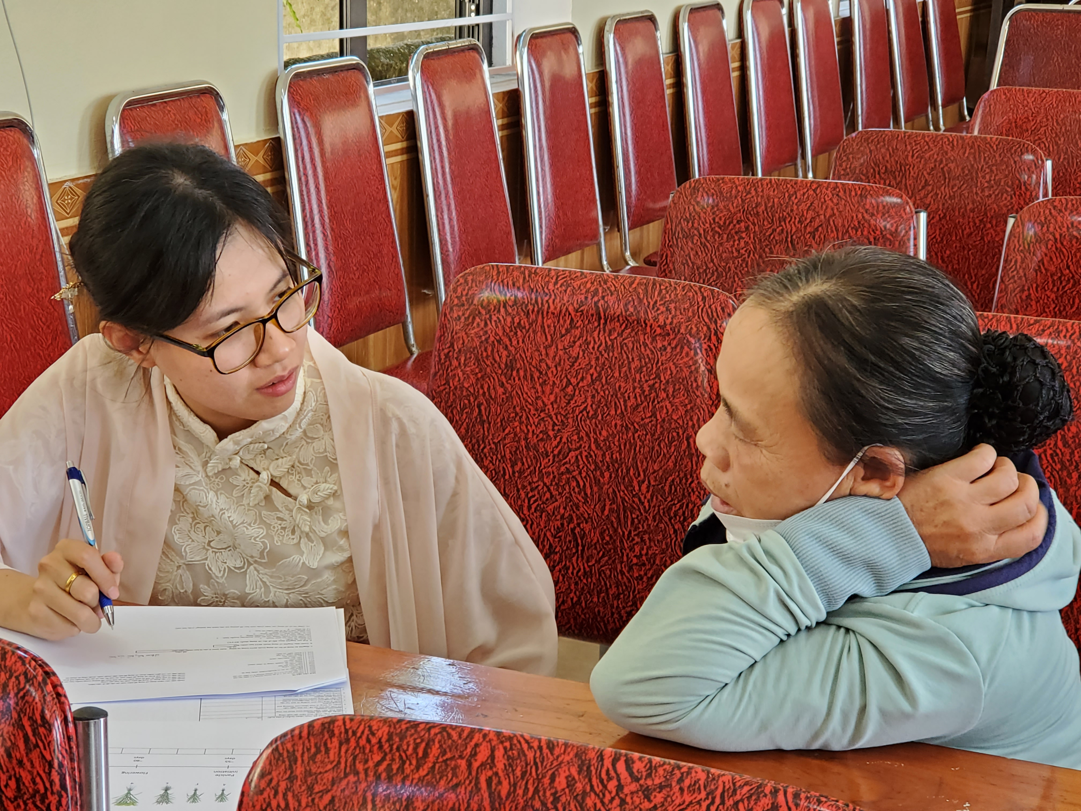
Our mixed-methods approach in 2023
Qual Interviews
(n=45)
Open-ended
Qual Piloting
(n=160)
Structured questionnaire but open-ended conversations
Field Testing of Survey Modules
(n=150)
Independent enumerators
VHLSS Questions 2023
Inductive coding
Diverse agro-ecological zones
Simple self-report
+
New domain-specific questions
Led to creation of new draft survey questions
Notes:
Monica
Qual interviews: 1 province (Dong Thap)
Qual piloting: 4 provinces
Field testing: 6 provinces

Slide 8

Our mixed-methods approach in 2023 (contd.)
Qual Interviews and Qual Piloting​
Centering farmers' expertise​
Cognitive empathy: understand farmers' logic, rationale, language and terminology to design questions that resonate with their lived experiences​
Field-testing of survey modules​
Testing if questions are effective with non-researcher enumerators​
Expanded scale across agroecological zones to test q’s’ generalizability.​
Notes:
Monica

Slide 9
Our findings
Theme 1: Measurability of Embodied Technologies (1M, 1R and 2R)
Theme 2: The Challenge of Disembodied Technologies (3R)
Theme 3: Structure and Agency (4R and 5R)
Notes:
Monica
The qualitative work gave us insights that allowed us to step back and think through each of the domains
We learned that not all domains were the same in terms of what needs to be measured, what is easy to measure, what is challenging to measure, why it is challenging.
We then clubbed different domains under these three themes
The findings are structured around these 3 themes.

Slide 10
Measurability of Embodied Technologies (1M, 1R and 2R)
Theme 1
Notes:
Monica

Slide 11
Theme 1: Measurability of Embodied Technologies
Embodied technologies: The innovation is contained in a tangible input, e.g., improved genetics in a seed or nutrients in a fertilizer.
Easier to measure adoption: The material form and physical act of purchasing, handling and applying provides a cognitive anchor for recall.
Three recommendations relate to embodied technologies, with implications for how and what to ask in a survey
Technology / Action | 1M5R | Recommendation
Improved Genetics in Certified Seeds | 1M | Use Certified Seeds
Physical handling of seeds | 1R | Reduce Seed rate: Max 120 kg/ha (Lenient) / Max 100 kg/ha (Strict)
Physical handling of fertilizer | 2R | Reduce fertilizer (Nitrogen component) Max 110kg/ha (Lenient) / Max 100kg/ha (Strict)
Notes:
Monica

Slide 12
1M: Use certified seeds
Theme 1
Notes:
Monica

Slide 13
Adoption of 1M: Are farmers using certified seeds?
2022
Binary Q
Do you use certified seeds? Y/N
2023
Qual interviews introduced nuance
(1) Only certified seeds (2) Combo certified/own seeds (3) Only self-produced or seeds from other farmers (4) Don't Know
Notes:
Monica

Slide 14
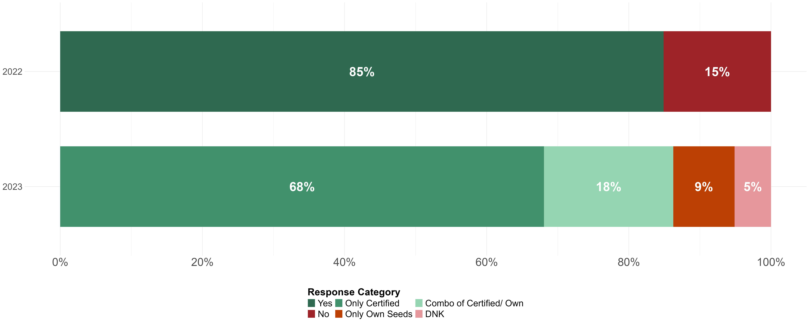
Adoption of 1M - Results – Comparison across 2022 and 2023
Notes:
Monica

Slide 15
1R: Reduce seed rate
Theme 1
Notes:
Monica

Slide 16
Adoption of 1R: Are farmers reducing seed rates? Can we attribute change in practices to 1M5R?
2022
Concerns about farmers' recall and numeracy skills
Question on Seeding Methods (Indirect Proxy)
2023
Qual interviews gave us confidence that direct elicitation is possible
Added qs on current rate, how long they have been using their current rate, previous rate
I reduced it gradually. First I reduced the seed rate to 18kg/1,000m² . I saw 18kg/1,000m² was fine. After that, I reduced it to 15kg/1,000m² to see how effective it was.
Notes:
Monica

Slide 17
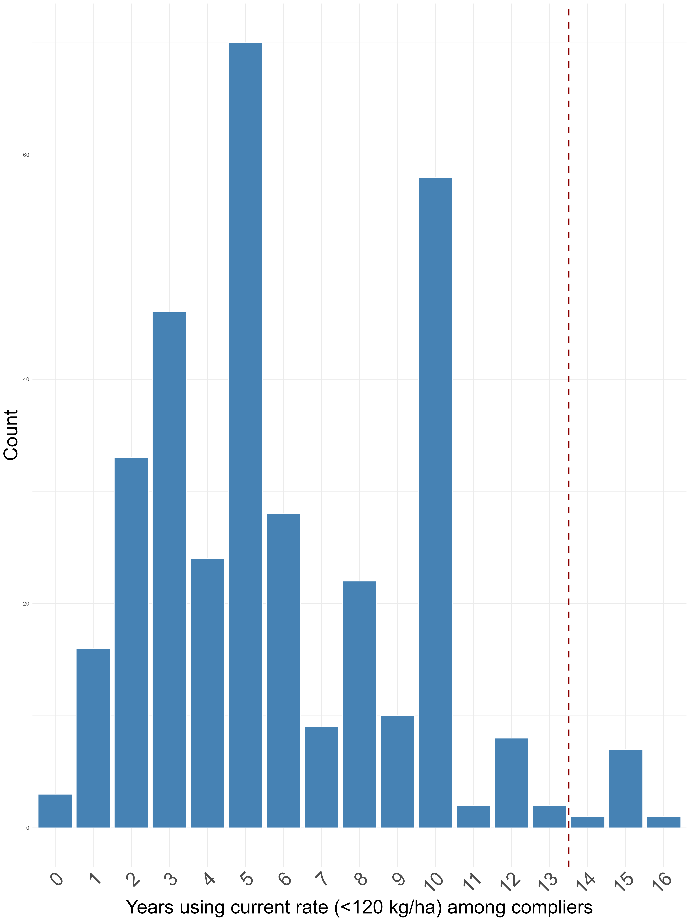
Adoption of 1R (Lenient criterion): Embodiment Supports Precise Recall and Temporal Attribution
 | Current rate >120 kg/ha | Current rate ≤120 kg/ha
Past rate >120 kg/ha | 17.1% | 2.8%
Past rate ≤120 kg/ha | 1.2% | 47.9%
Total | 18.3% | 50.7%
Don’t know | 7.9% | 23.1%
Timing of change among the 2.8%
Notes:
Sujata
First, using the lenient criterion of 120 kg/ha – we find that 50.7% of farmers were following the 1R recommendation in 2023.
Because we asked about the current rate, past rate and also how long they had been using the current rate – we can infer whether farmers have changed their behavior, and if so, when. This helps us make some progress toward attribution, in terms of timing. So 50.7% were following the 1R recommendation in 2023, but most of them (48%) were also following the recommendation previously. So it appears that only 2.8% of farmers had lowered their seed rate from above 120 kg to below 120 kg – i.e. gone from being non-adopters to adopters.
On the right we show their responses to the question “when did you change your seed rate?” Among the 2.8% who newly became adopters, the majority made the change less than 13 years ago – so it is possible that the change was due to the 1M5R recommendation.
------------------------------------Pattern doesn’t look that different in terms of strict criterion now: r > 100 kg; now: r <=100 kg
past: r>100 kg ; 0.212317; 0.02854339
past: r <= 100 kg; 0.01218615; 0.43690194
past: Dnk; 0.09593523; 0.2141163
-----------------------------------some more analysis possible? Helpful? How many went from 100-120 kg to <=100 kg? need to also investigate if 3R3G recos were different from 1M5R so that movement from 100-120 to <100 can be attributed to 1M5R.
----------------------------------or alternatively can we say that the previous change had happened due to 3R3G?

Slide 18
2R: Reduce fertilizer use
Theme 1
Notes:
Hand back to Monica

Slide 19
Adoption of 2R: More complex case of embodiment
Like seeds, fertilizers are physical inputs, purchased in known quantities and deliberately applied
But unlike seeds, fertilizers have a 3-part recommendation
The bundle requires separate measures for applications, timing and N quantity
Recommendation |  | Measurement Challenge
No. of applications | Min 2 splits (lenient) Min 3 splits (strict) | Recall
Appropriate timing | Between tillering and panicle initiation (lenient and strict) | How to ask about timing?
Appropriate quantity of N | 110 kg N/ha (lenient) 100 kg N/ha (strict) | Farmers may use multi-component fertilizers where N is only one of the components Key asymmetry with seeds: With seeds, product is the unit of measurement. With fertilizer, product must be converted to nutrient, not all farmers know the conversion rate.
Notes:
Monica

Slide 20
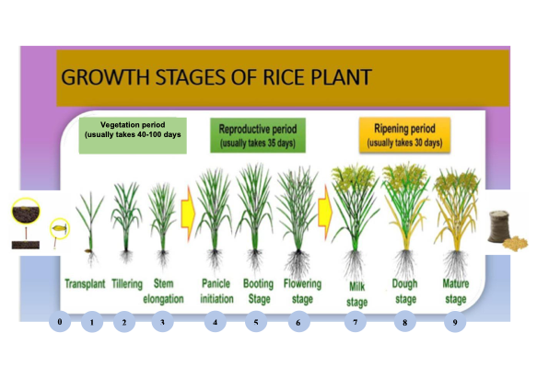
Adoption of 2R: Questions on Number and Timing of Applications
Design Problem | Qual Insights | 2023 Survey Design
How to ask about number and timing? | Farmers think in crop cycles, not calendar dates Anchor qs to crop growth stages | Used visual aid showing rice growth stages as a showcard Created a roster of all applications Standardizable across regions With roster and visual aid, captured both number and timing
Notes:
Monica

Slide 21
Adoption of 2R: Question on Quantity of Nitrogen
Design Problem | Qual Insights | 2023 Survey Design
How to measure nitrogen quantity when farmers use multi-component fertilizers? | Recall was not the problem — farmers reported fertilizer type and quantity per land unit with precision, using regional area variants: sào Bắc Bộ (360m²), sào Trung Bộ (500m²), sào Nam Bộ / công nhà nước (1,000m²), công tầm cắt (1,296m²) Specifying N:P:K ratios for compound fertilizers was a challenge | Ask whether they knew their fertilizer's chemical formula (e.g., 20:20:15) Enables nitrogen calculation where known Systematically flags uncertainty where chemical formula is unknown
Urea fertilizer, 7kg. And Kali, 1kg... 10 kg the second time... 10 kg of DAP... then 7kg for Kali and 3kg for Urea. It also depends on the color of the rice.
Notes:
Monica

Slide 22
Adoption of 2R (lenient criterion): Results
82.6% of farmers could recall their formula mix for fertilizers
Adoption rate among these farmers:
 | Adoption Rate
Applied in at least 2 splits | 80%
+ Applied less than 110 N kg/ ha | 50%
+ Applied at the correct timing | 20%
Notes:
Monica

Slide 23
The Challenge of Disembodied Technologies (3R)
Theme 2
Notes:
Monica

Slide 24
Theme 2: The Challenge of Disembodied Technologies
Disembodied technologies: The innovation is a set of decision principles, not a physical input
Harder to measure adoption: Recommendation lives in farmers' reasoning.
3R comprises 3 distinct recommendations on number, timing and trigger
Recommendation |  | Measurement Challenge
Limit Applications | Max 6 applications (Lenient) <2 fungicides and <1 insecticides (Strict) | Recall Language/terminology
Appropriate Timing | No application before panicle initiation or after dough stage (Lenient) No insecticide before panicle initiation and no application after flowering (Strict) | How to ask about timing?
Appropriate Trigger (Decision Principle) | No preventive spraying. Apply only if scouting reveals pests. Avoid any application if the plant can regrow from damages. | Recommendation lives in farmers' reasoning, not a tangible product. What counts as scouting? What level of potential harm should trigger an application?
Notes:
Monica

Slide 25
Adoption of 3R: What qual interviews revealed about applications
2023 Qual Insight
Farmers use term "pesticides" for any agrochemical – e.g., to kill weeds, rodents, snails (not part of 3R)
Use the broad term "plant protection drugs" for more precision
Q: In what situation do you decide to spray pesticides? R: Do you want to ask about pesticides on grass or pests?
2022
Single question: How many times did you apply pesticides, insecticides and fungicides?
No questions on timing or triggers
Redesign - 2023 Survey Qs | In the last WS season, how many times did you apply plant protection drugs on your main plot, including herbicides, molluscicides, insecticides, fungicides and rodenticides? | Of these, how many times did you apply insecticides and fungicides? | If 0, do you normally experience bugs, diseases or fungus on your main plot? (1) Yes (2) No
Notes:
Monica

Slide 26
Adoption of 3R: From Qual Insights to 2023 Survey Questions
 | Design Problem | Qual insights | Redesigned 2023 Survey Qs
1. | How to separately count fungicides and insecticides? | • Farmers may not know whether they had used an insecticide or a fungicide • But they were more likely to know what object (pest/disease) they were targeting • Worked with an entomologist to create a pictorial list of "objects" | For which object(s) are you using this plant protection drug? • Pictorial list shown; enumerator chooses from multiple objects • Enables calculation of strict criterion: ≤1 insecticide and ≤2 fungicide applications
Notes:
Monica

Slide 27
Adoption of 3R: From Qual Insights to 2023 Survey Questions (continued)
 | Design Problem | Qual insights | Redesigned 2023 Survey Qs
2. | How to ask about the timing of applications? | Farmers recall events by crop growth stages, not calendar dates | • Visual aid of rice growth stages used as showcard • Roster of all applications, with farmer indicating growth stage at time of each application
3. | How to ask about the trigger? | We could ask for the farmer's reasoning behind the application | What was the purpose of this application? (1) Prevention / (2) Treatment / (3) Nutrient / (99) Don't know
Notes:
Monica

Slide 28
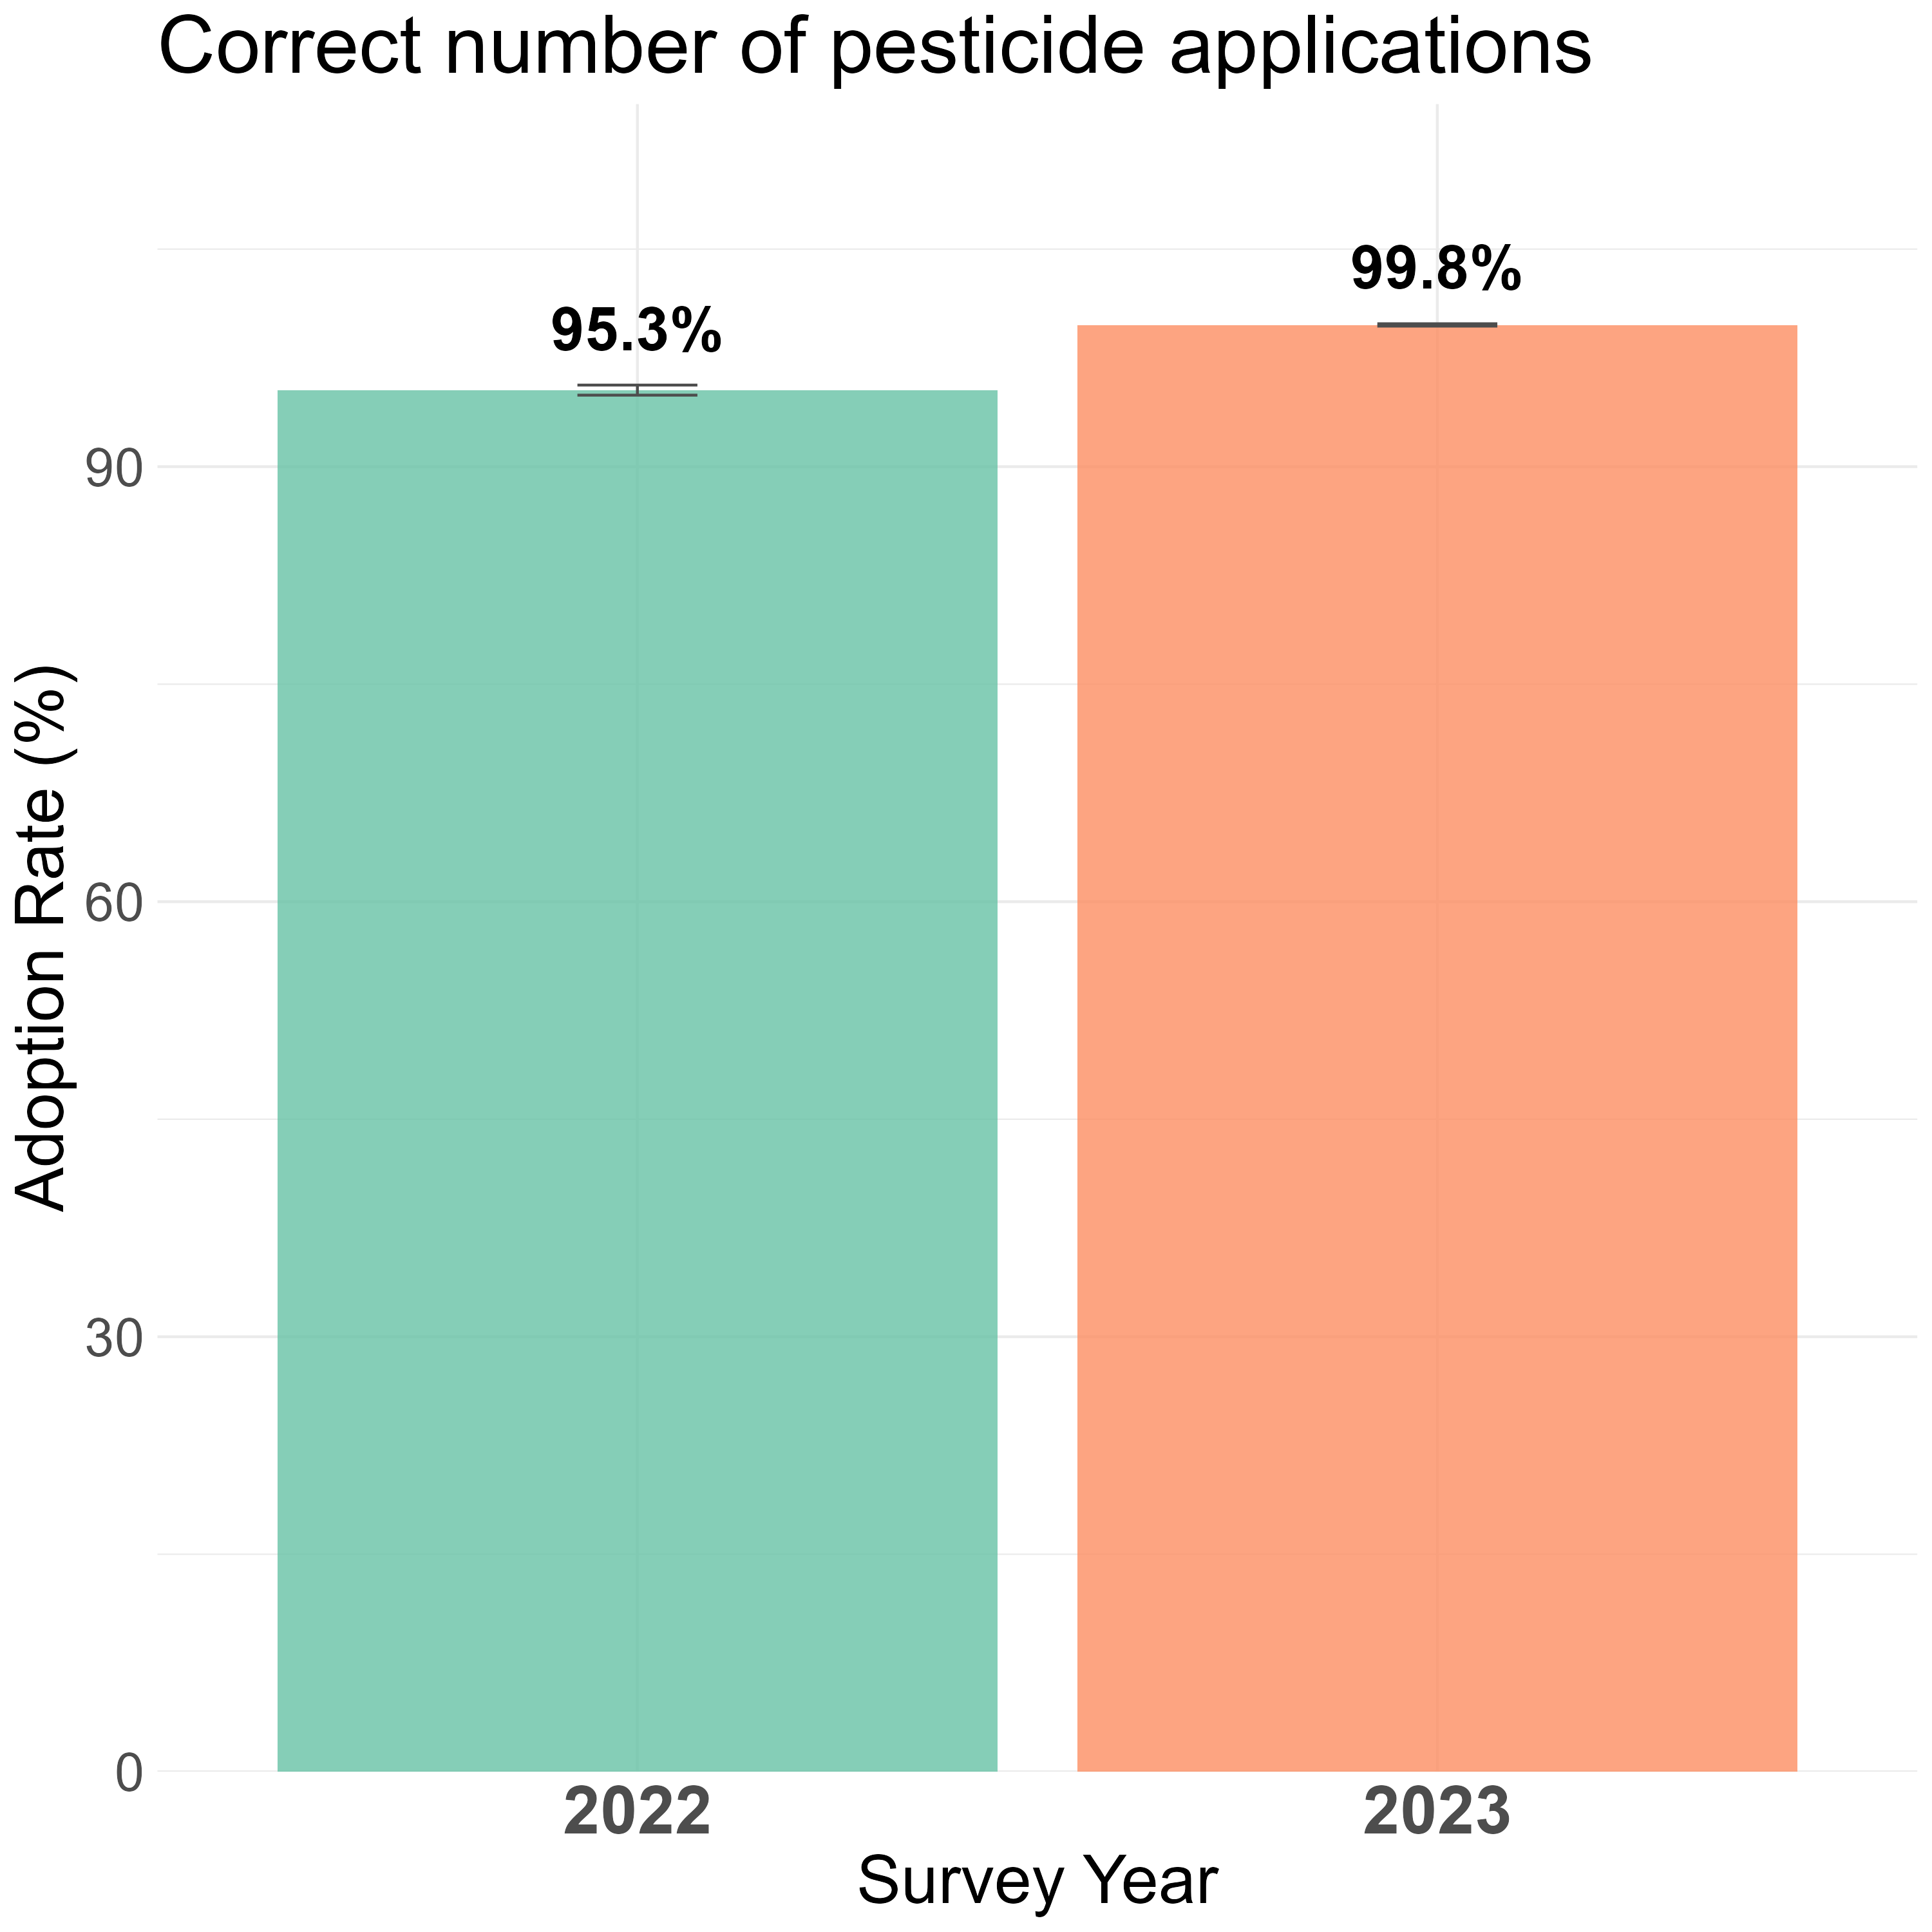
Adoption of 3R (lenient criterion): Results
 | Percent
Correct number of applications (3 insecticides and 3 fungicides) | 99.8%
+ Correct timing (no application before panicle initiation or after dough stage ) | 23.5%
+ Applied for treatment only | 15.8%
Notes:
Sujata

Slide 29
The Limits of Measurability of Disembodied Technologies: Attribution
Questions on temporal attribution did not work — because there was no discrete moment of adoption for farmers to recall.
Pest pressure fluctuates year to year: Every year, there are many types of pests that make me change the pesticides… I have to change because the pest is resistant to the old pesticide.
Decisions respond to fear of crop failure, not to a method: The only thing I fear the most is the sâu nhíu which eats the rice stem and the rice panicle gets damaged. We just know if pests are found, we have to take timely action.
Social conformity is continuous, not a one-time event: If there were a brown planthopper, other farmers sprayed it, but I didn't, then I would get nothing left to harvest… I would feel ashamed.
Notes:
Monica

Slide 30
Structure v. Agency problem (4R & 5R)
Theme 3
Notes:
Monica

Slide 31
4R: Reduce water use (AWD - Alternate Wetting and Drying)
Theme 3
Notes:
Monica

Slide 32
Structure and Agency in Water Use (4R)
AWD (4R) is a disembodied technology — a set of water management principles asking rice farmers to periodically dry their fields rather than keep them continuously flooded.
The prior issue: Did the farmer have agency at all? A dry-down may result from farmer choice, cooperative scheduling, or topography — without distinguishing these, the three pillars below cannot be meaningfully measured.
Recommendations |  | Measurement Challenge
Number | Min 2 dry-downs (Lenient and Strict) | Recall – how many times? And how much control did the farmer have?
Depth | All dry-downs to –15cm below the surface (Strict) At least one dry-down to –15 cm below the surface (Lenient) | Translating a technical threshold into a farmer-legible indicator
Timing | Between Transplanting and Max Tillering (Strict) No Timing requirement (Lenient) | How to ask about timing?
Notes:
Monica

Slide 33
Adoption of 4R: 2022 Questions
Are you familiar with AWD? (1) Yes (2) No
Have you ever applied AWD?
(1) Yes (2) No
Did you apply AWD in the last Winter-Spring season?
(1) Yes (2) No
Notes:
Monica

Slide 34
Adoption of 4R: From Qual Insights to 2023 Survey Questions
 | Design Problem | Qual insights | Redesigned 2023 Survey Qs
1. | Who controls the water? | Determine whether AWD is even possible | Which water source did you use to irrigate your fields? Cooperative/irrigation service center / Agent level II / Only own pump / Own pump and others / Other
2. | Enabling embodied investments | Laser levelling and water tubes enable AWD | Has your largest plot been levelled with a laser levelling machine? Yes/No/Don't know + Are you using a water pipe/tube to measure water level? Yes/No/Don't know
3. | How many dry-downs? | Entry point to the roster | How many times did your largest plot dry? [Number]
Notes:
Monica

Slide 35
Adoption of 4R: From Qual Insights to 2023 Survey Questions
 | Design problem | Qual insights | Redesigned 2023 Survey Qs
4. | When did dry-downs occur? | Locating events within the crop cycle improves recall and establishes whether timing matches AWD specifications | For each dry-down: At what stage/between stages were the rice plants? [rice growth stages showcard, stages 0–20]
5. | What caused each dry-down? | Must distinguish structure from agency | What reason caused the soil to dry? I actively drained / Cooperative drained / Cooperative stopped pumping / Cooperative pumped but not enough / Mound land / Sunny hot weather / Other / Don't know
6. | How dry was the field? | Without water tubes, difficult for farmers to measure subsurface water; need a farmer-legible proxy | How much did your feet sink when you stepped on the soil? (in cm) [Number]
Notes:
Monica

Slide 36
Control correlates with adoption
Degree of water control | % of all hhs | % >= 2 drydowns | + Correct timing | + Intentional dry-down | + Length ( >5 days) | Wetness Degree (sinking cm)
 | (1) | (2 = % of 1) | (3 = % of 1) | (4 = % of 1) | (5 = % of 1) | (6 = among 5)
Full control (farmers own pumps / water line) | 11.6% | 74.2% | 56.9% | 49.1% | 35.0% | 7.0
Partial control (farmers own pumps / sluice but rely on water release from system) | 19.6% | 50.9% | 36.0% | 18.5% | 11.8% | 6.8
Very limited control (farmers do not own pumps; dykes prevent ingress or allow egress) | 62.1% | 62.3% | 41.3% | 33.8% | 22.1% | 5.5
Notes:
Sujata
Since we had asked farmers about their irrigation water source, we can divide them into those who have full control over water – i.e. they own pumps or a water line, v. those with partial control – they still depend on water being released from the reservoir, but can influence how much and when the water reaches their field, v. those with very limited control – they depend on the system for quantity and timing, but have built dykes to prevent water from coming in or leaving).
First, note that the majority of farmers (62%) have very limited control over irrigation. Among them, 62% had at least 2 drydowns. When we check the timing of dry-down, 41% had that + the >=2 drydowns, and when we further add the criteria of whether it was intentional (i.e. it was not due to heat or topography) the number falls to 34%, and then further falls to 22% if we check length of dry-down. So overall, we would say 22% of these farmers met the criterion of 4R.
Compare that to farmers with partial control, about half the adoption rate at 12%.
But among farmers with full control, adoption rate is higher 35%.
While this is not causal – it does suggest that a) farmers with full control are more likely to implement 4R and possibly this is enabled by their full control, but b) even coops can influence whether 4R is adopted – by selecting the timing of water release.

Slide 37
5R: Reduce post-harvest losses
Theme 3
Notes:
Monica

Slide 38
Adoption of 5R: 2022 Questions
Which method did you use for harvesting?
(1) Manual labor (2) Mini combine harvester/2WT (3) Combine harvester (4) Straw baler (5) Other
Question focused on embodied technology, not agronomic decision
No question on drying or storage
Notes:
Monica

Slide 39
5R: From Qual Insights to Survey Questions (Part 1: Harvest)
 | Design Problem | Qual Insight | 2023 Survey Design
1. | How to measure harvest timing? | Farmers report % ripeness at harvest with precision, distinguishing fine gradations daily | When did you start harvesting rice? 70–80% grains per panicle were straw colored / yellow (2) 80–90% (3) 90–100%
2. | How to measure harvesting method? |  | Which method did you mostly use for harvesting? (1) Combine harvester (2) Straw baler (3) Manual labor (4) Other For how long have you been using this harvesting method? [Years]
Notes:
Monica

Slide 40
5R: From Qual Insights to Survey Questions (Part 2: Drying and Storage)
 | Design Problem | Qual Insight | 2023 Survey Design
3. | How to measure drying? | • In the Mekong Delta, farmers sell wet/fresh rice immediately — drying is outside their control and question not applicable • In other regions, farmers dry their own rice and can report drying method | Which method did you use to dry your rice? (1) Field drying (2) Sun drying on road or home ground (3) Sun drying using mat or pavement (4) Heated air drying (5) Low-temperature drying (6) Solar drying (7) Don't know (8) Other How long have you been using this drying method? [Number]
4. | How to measure moisture content? | Farmers assess dryness by biting grain and listening for sound — same method used by traders at purchase | How did you check moisture content of your rice? (1) I don't check / (2) Checked by hand / (3) Used a machine / (4) The buyer checks
5. | How to measure storage? | Where farmers retain rice, bag type is known and easily reportable | How did you store your rice? (1) No storage, sold fresh (2) Storage in bags (3) Bulk storage (4) Hermetic storage (Cocoon or Super Bag) (5) Other
Notes:
Monica

Slide 41
Adoption of 5R: 2023 results
 | Type of rice sold
 | Dry | Wet / fresh
% of all hhs | 90.1% | 9.9%
% Use combine harvesters | 61.5% | 98.5%
+ Correct timing (80-90% yellow grains / panicle) | 15.6% | 15.8%
+ “Correct” drying (using machines) | 0.03%
+ “Correct” storage (in bulk/bags and check moisture content) | 0.0%
 | Lenient criteria
5R-H | Harvest when 80-90% grains/panicle straw-colored or yellow + Use combine harvester or certified thresher
5R-D | Dry evenly within 24h at ≤ 43C in flatbed recirculating columnar dryers
5R-S | Store grain within 3 months at ≤ 14% moisture, seeds ≤ 12% moisture in bags or bulk.
Notes:
Sujata

Slide 42
1M5R Adoption rate estimates
2022 and 2023

Slide 43
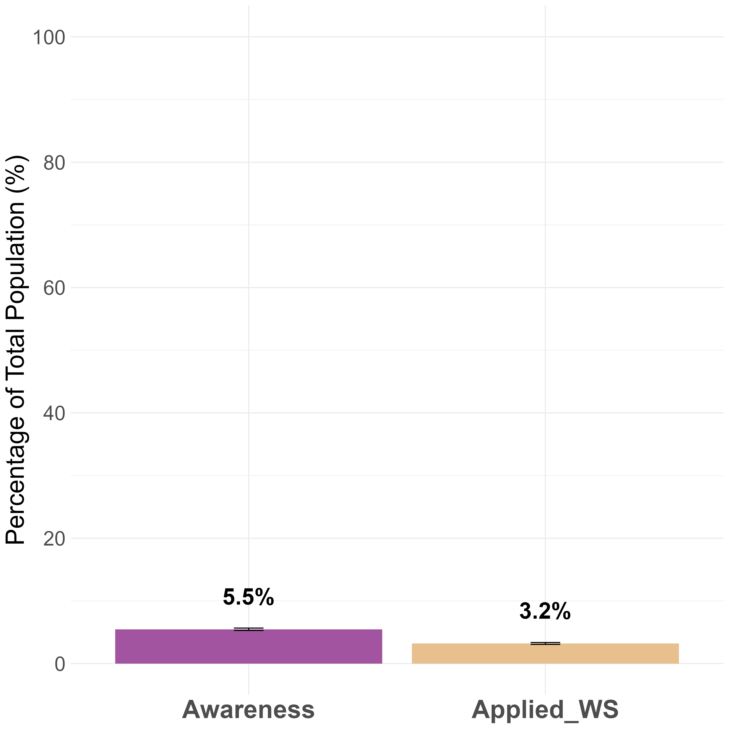
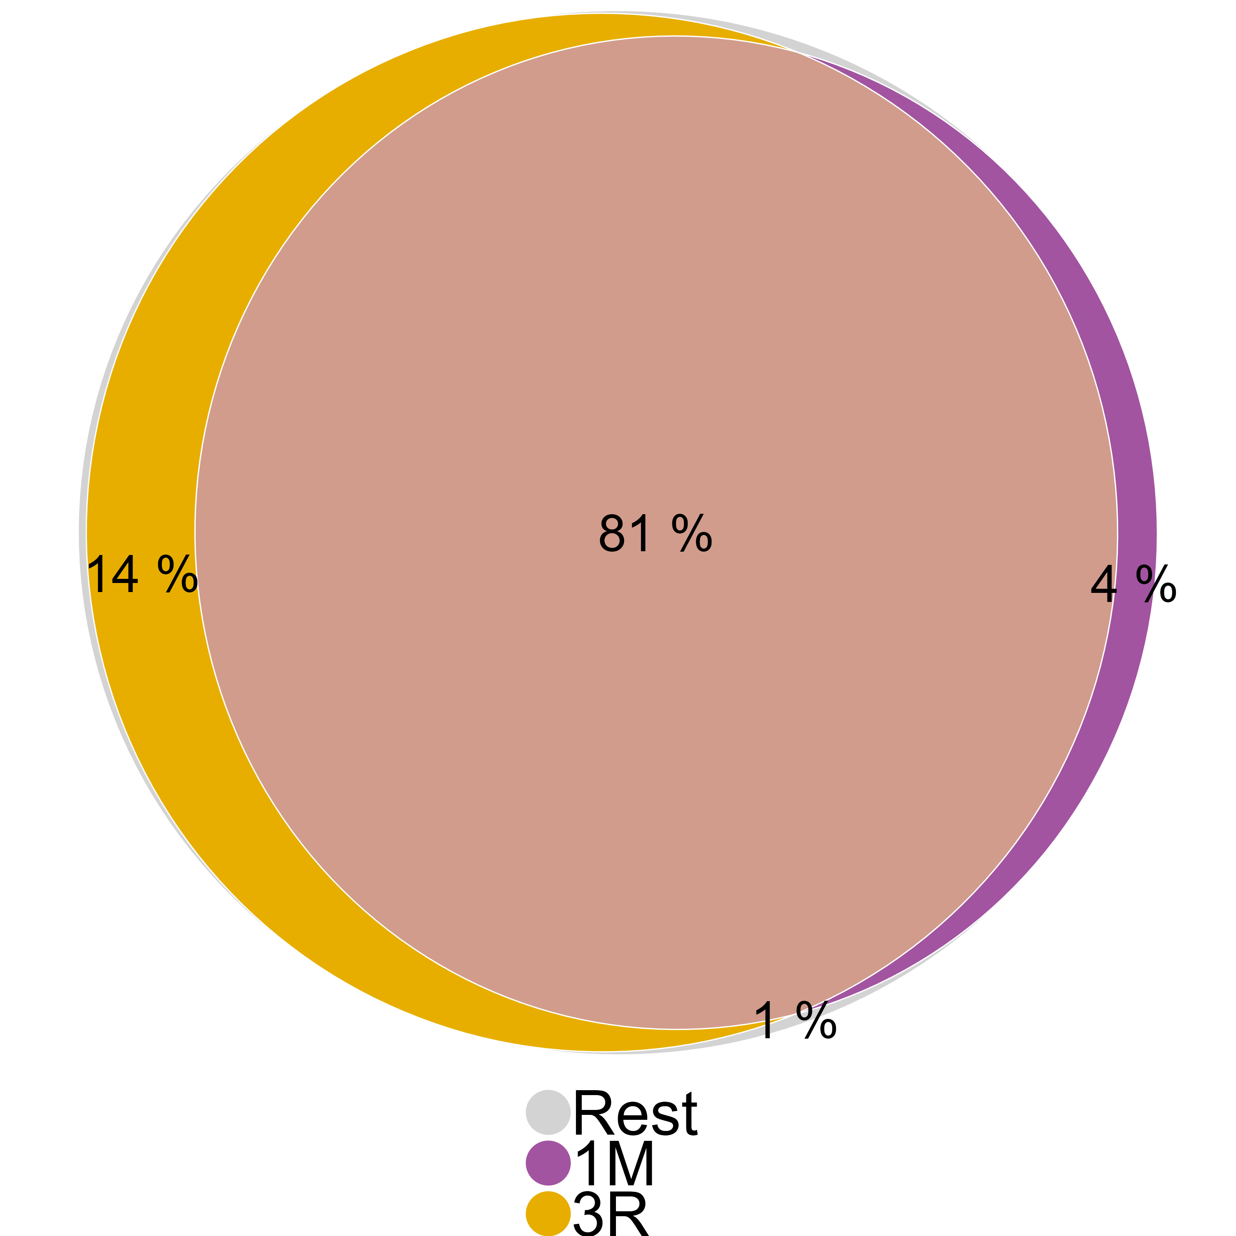
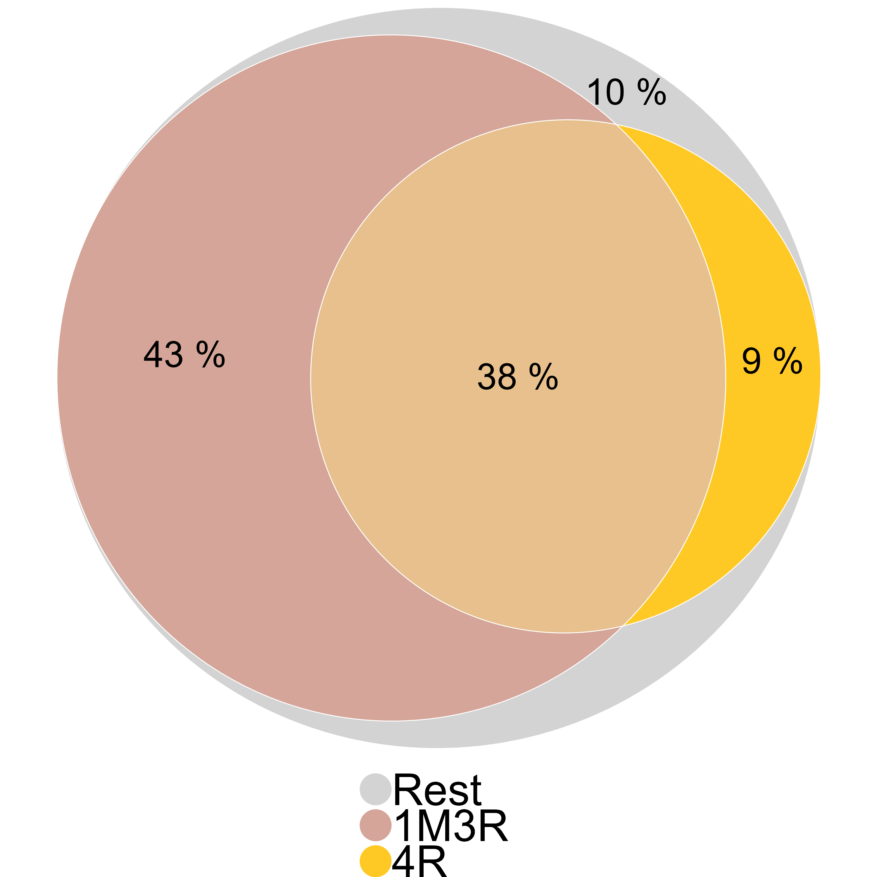
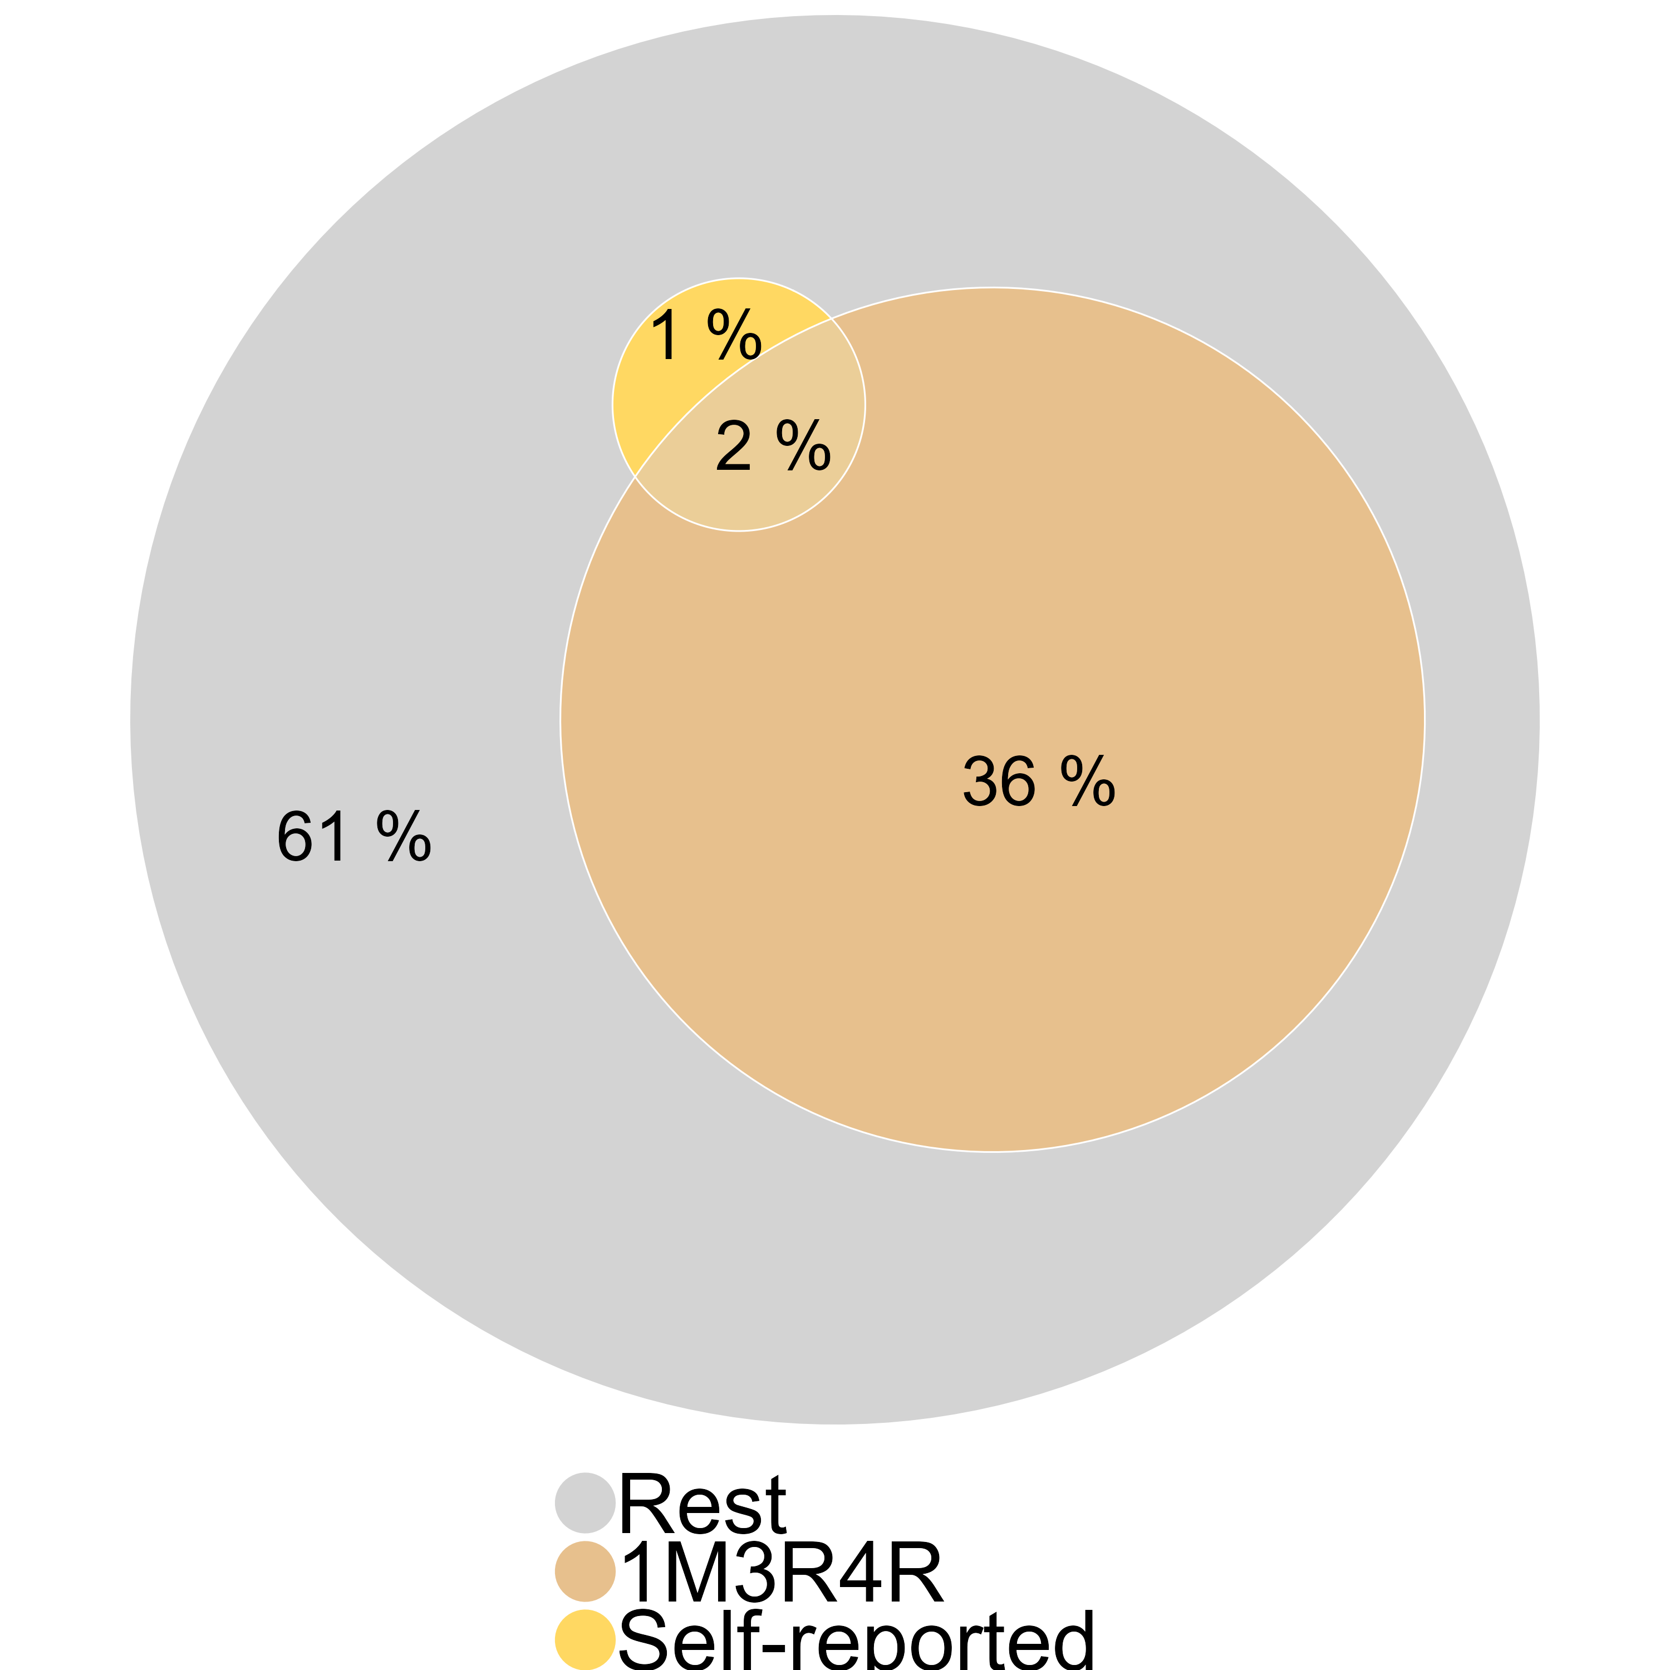
Adoption estimates from 2022 (lenient criteria)
Simple estimate
Constructed from domain-specific questions
Limited to 1M (certified seeds), 3R (reduce pesticides) and 4R (reduce water / AWD)
Certified seeds (1M) + Pesticides (3R)
1M3R
+ AWD (4R)
1M3R4R
+ Self-reported adoption
Aware of 1M5R
Applied 1M5R
Notes:
Sujata
Start with the estimates from the simple questions: Are you aware of the 1M5R package of recommendations? If yes, did you apply it in the last winter-spring season? Only 5.5% said they were aware, and only 3.2% said they had applied it.
Since we also had domain-specific questions for 3 domains, we can evaluate whether their actions were in line with the recommendations and construct our own estimate – the fraction of households who followed each recommendation. We do this sequentially.
To start with, we had 85% of households who reported using certified seeds, and we had 95% who said they had applied pesticides 6 or fewer times. The intersection set is 81%.
When we add on the water recommendation, 47% of households said they had followed AWD. And so the intersection set is 38%: 38% of households had followed 1M, 3R and 4R.
Contrast that with the 3.2% who had said they were following 1M5R – one-third of the households that said they were following the entire bundle of recommendations were not even following 1M3R4R. But two-third were.

Slide 44
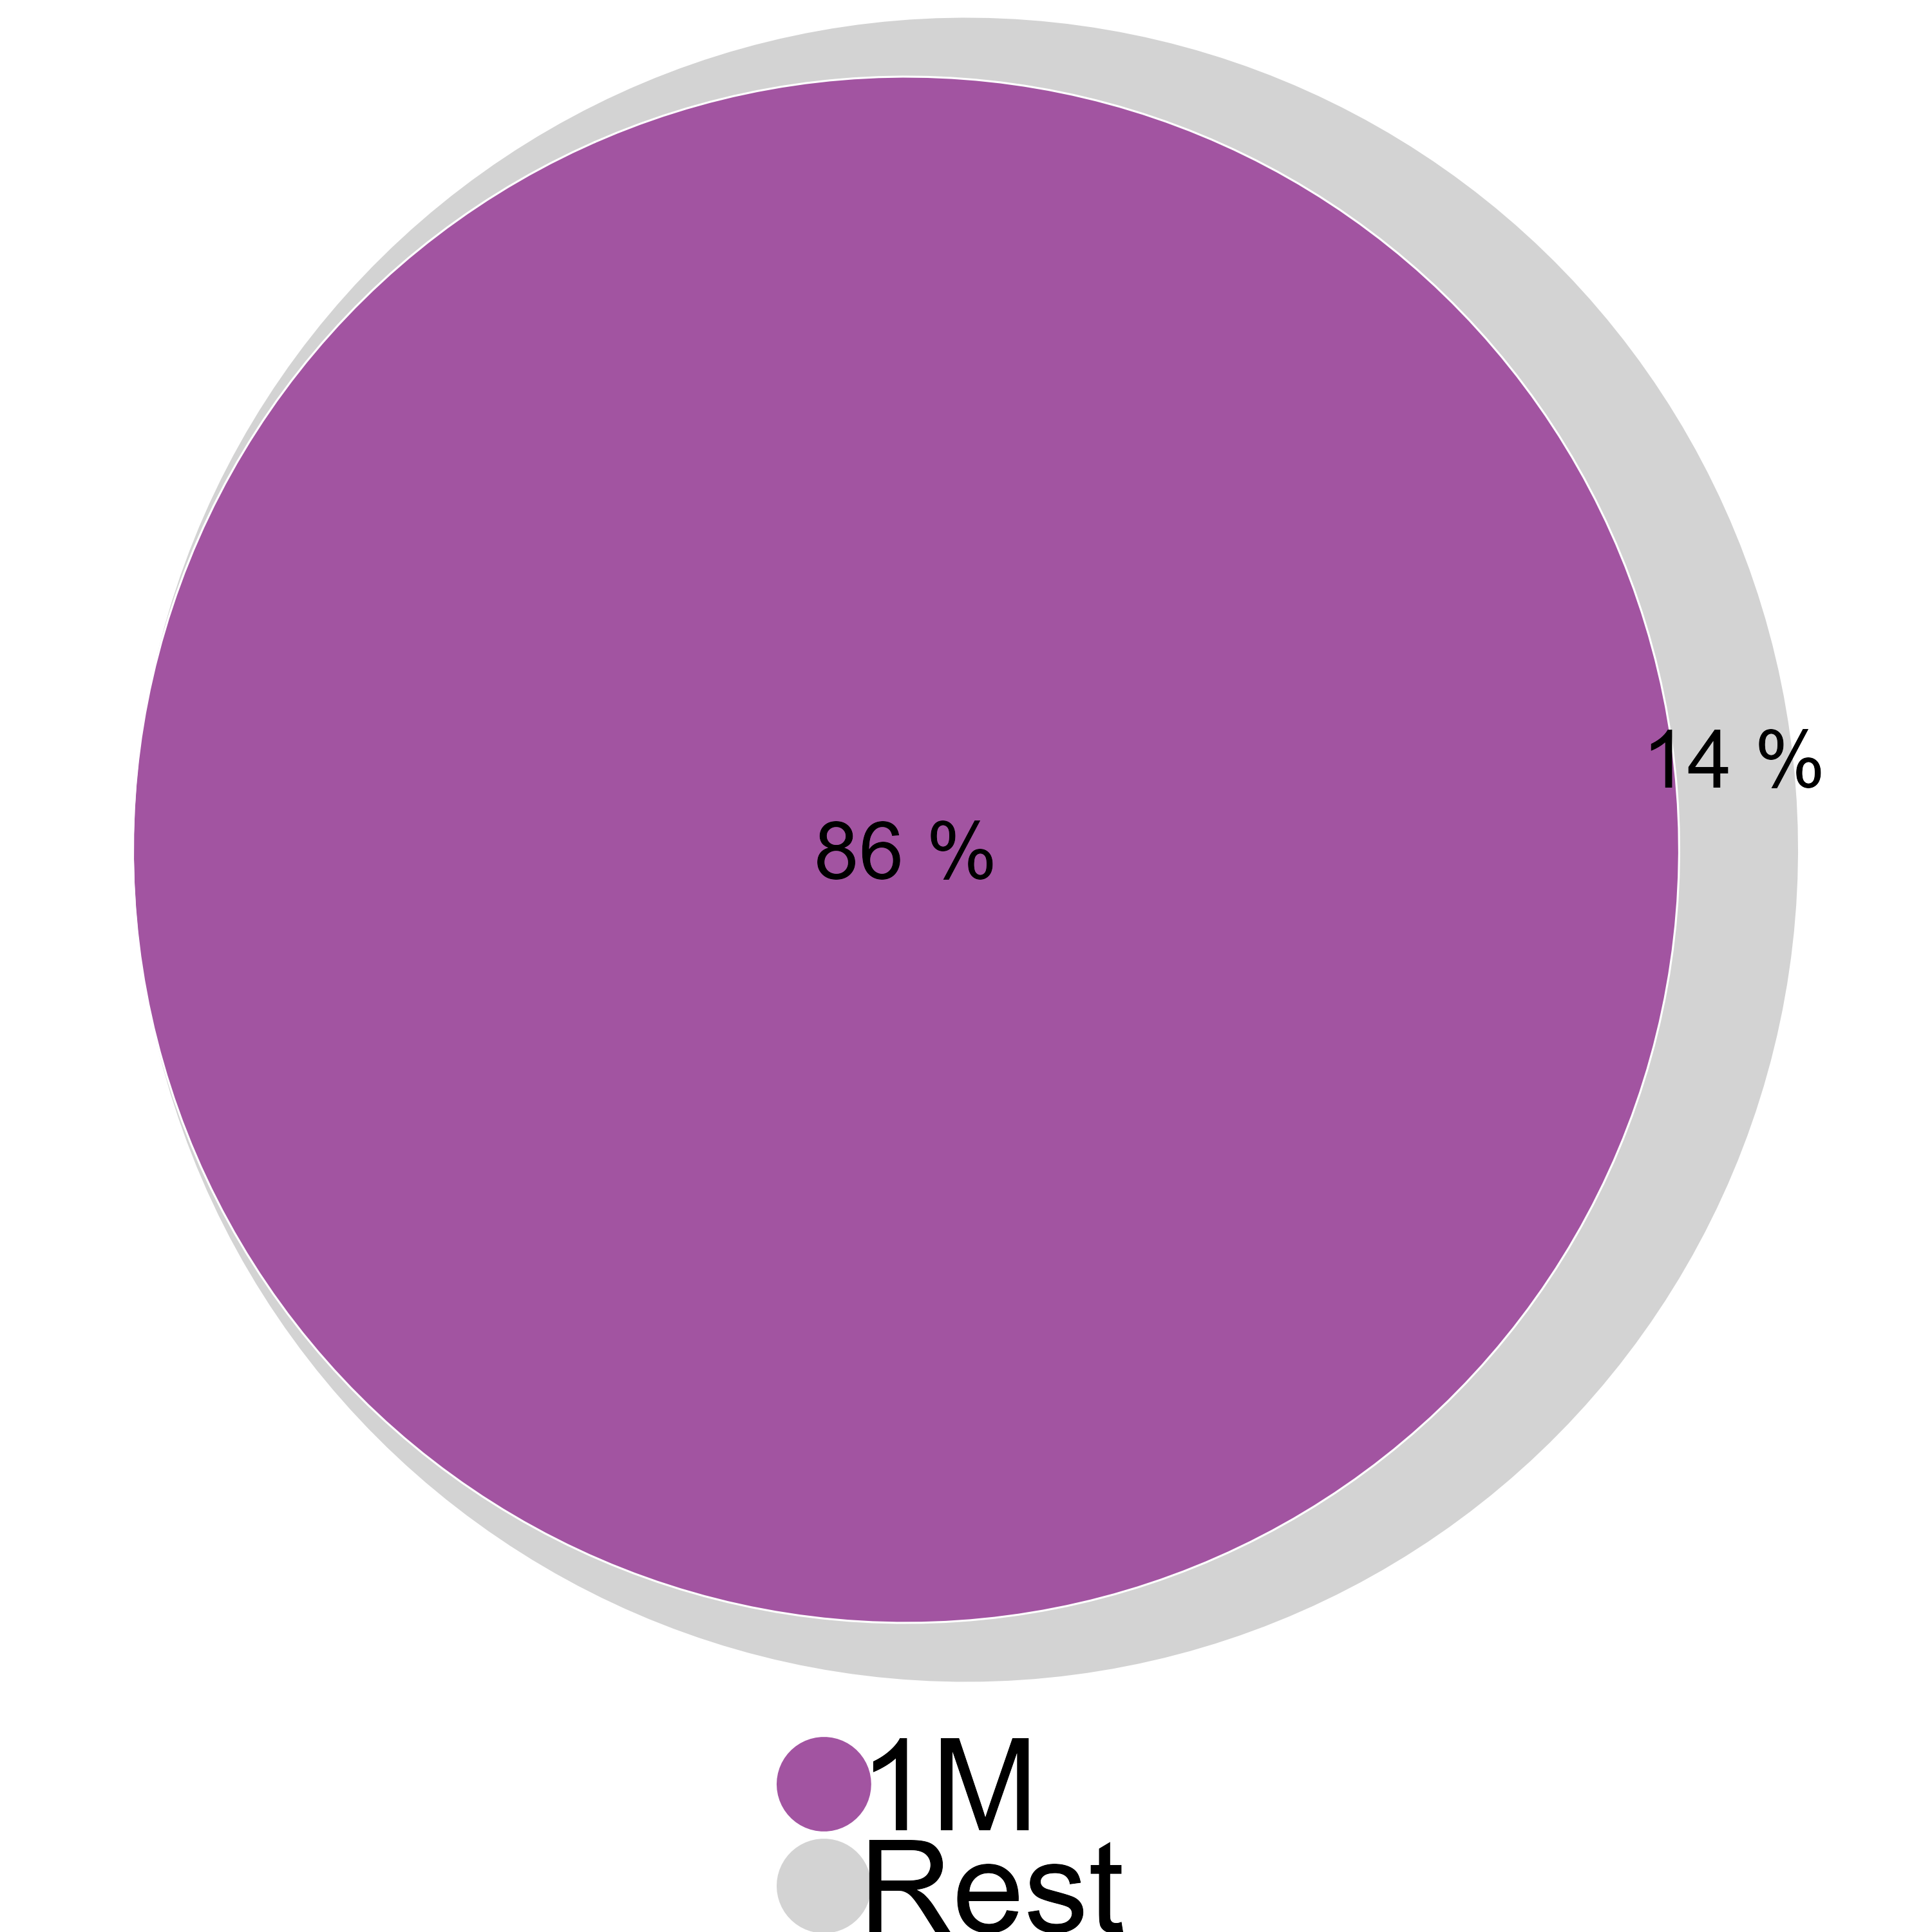
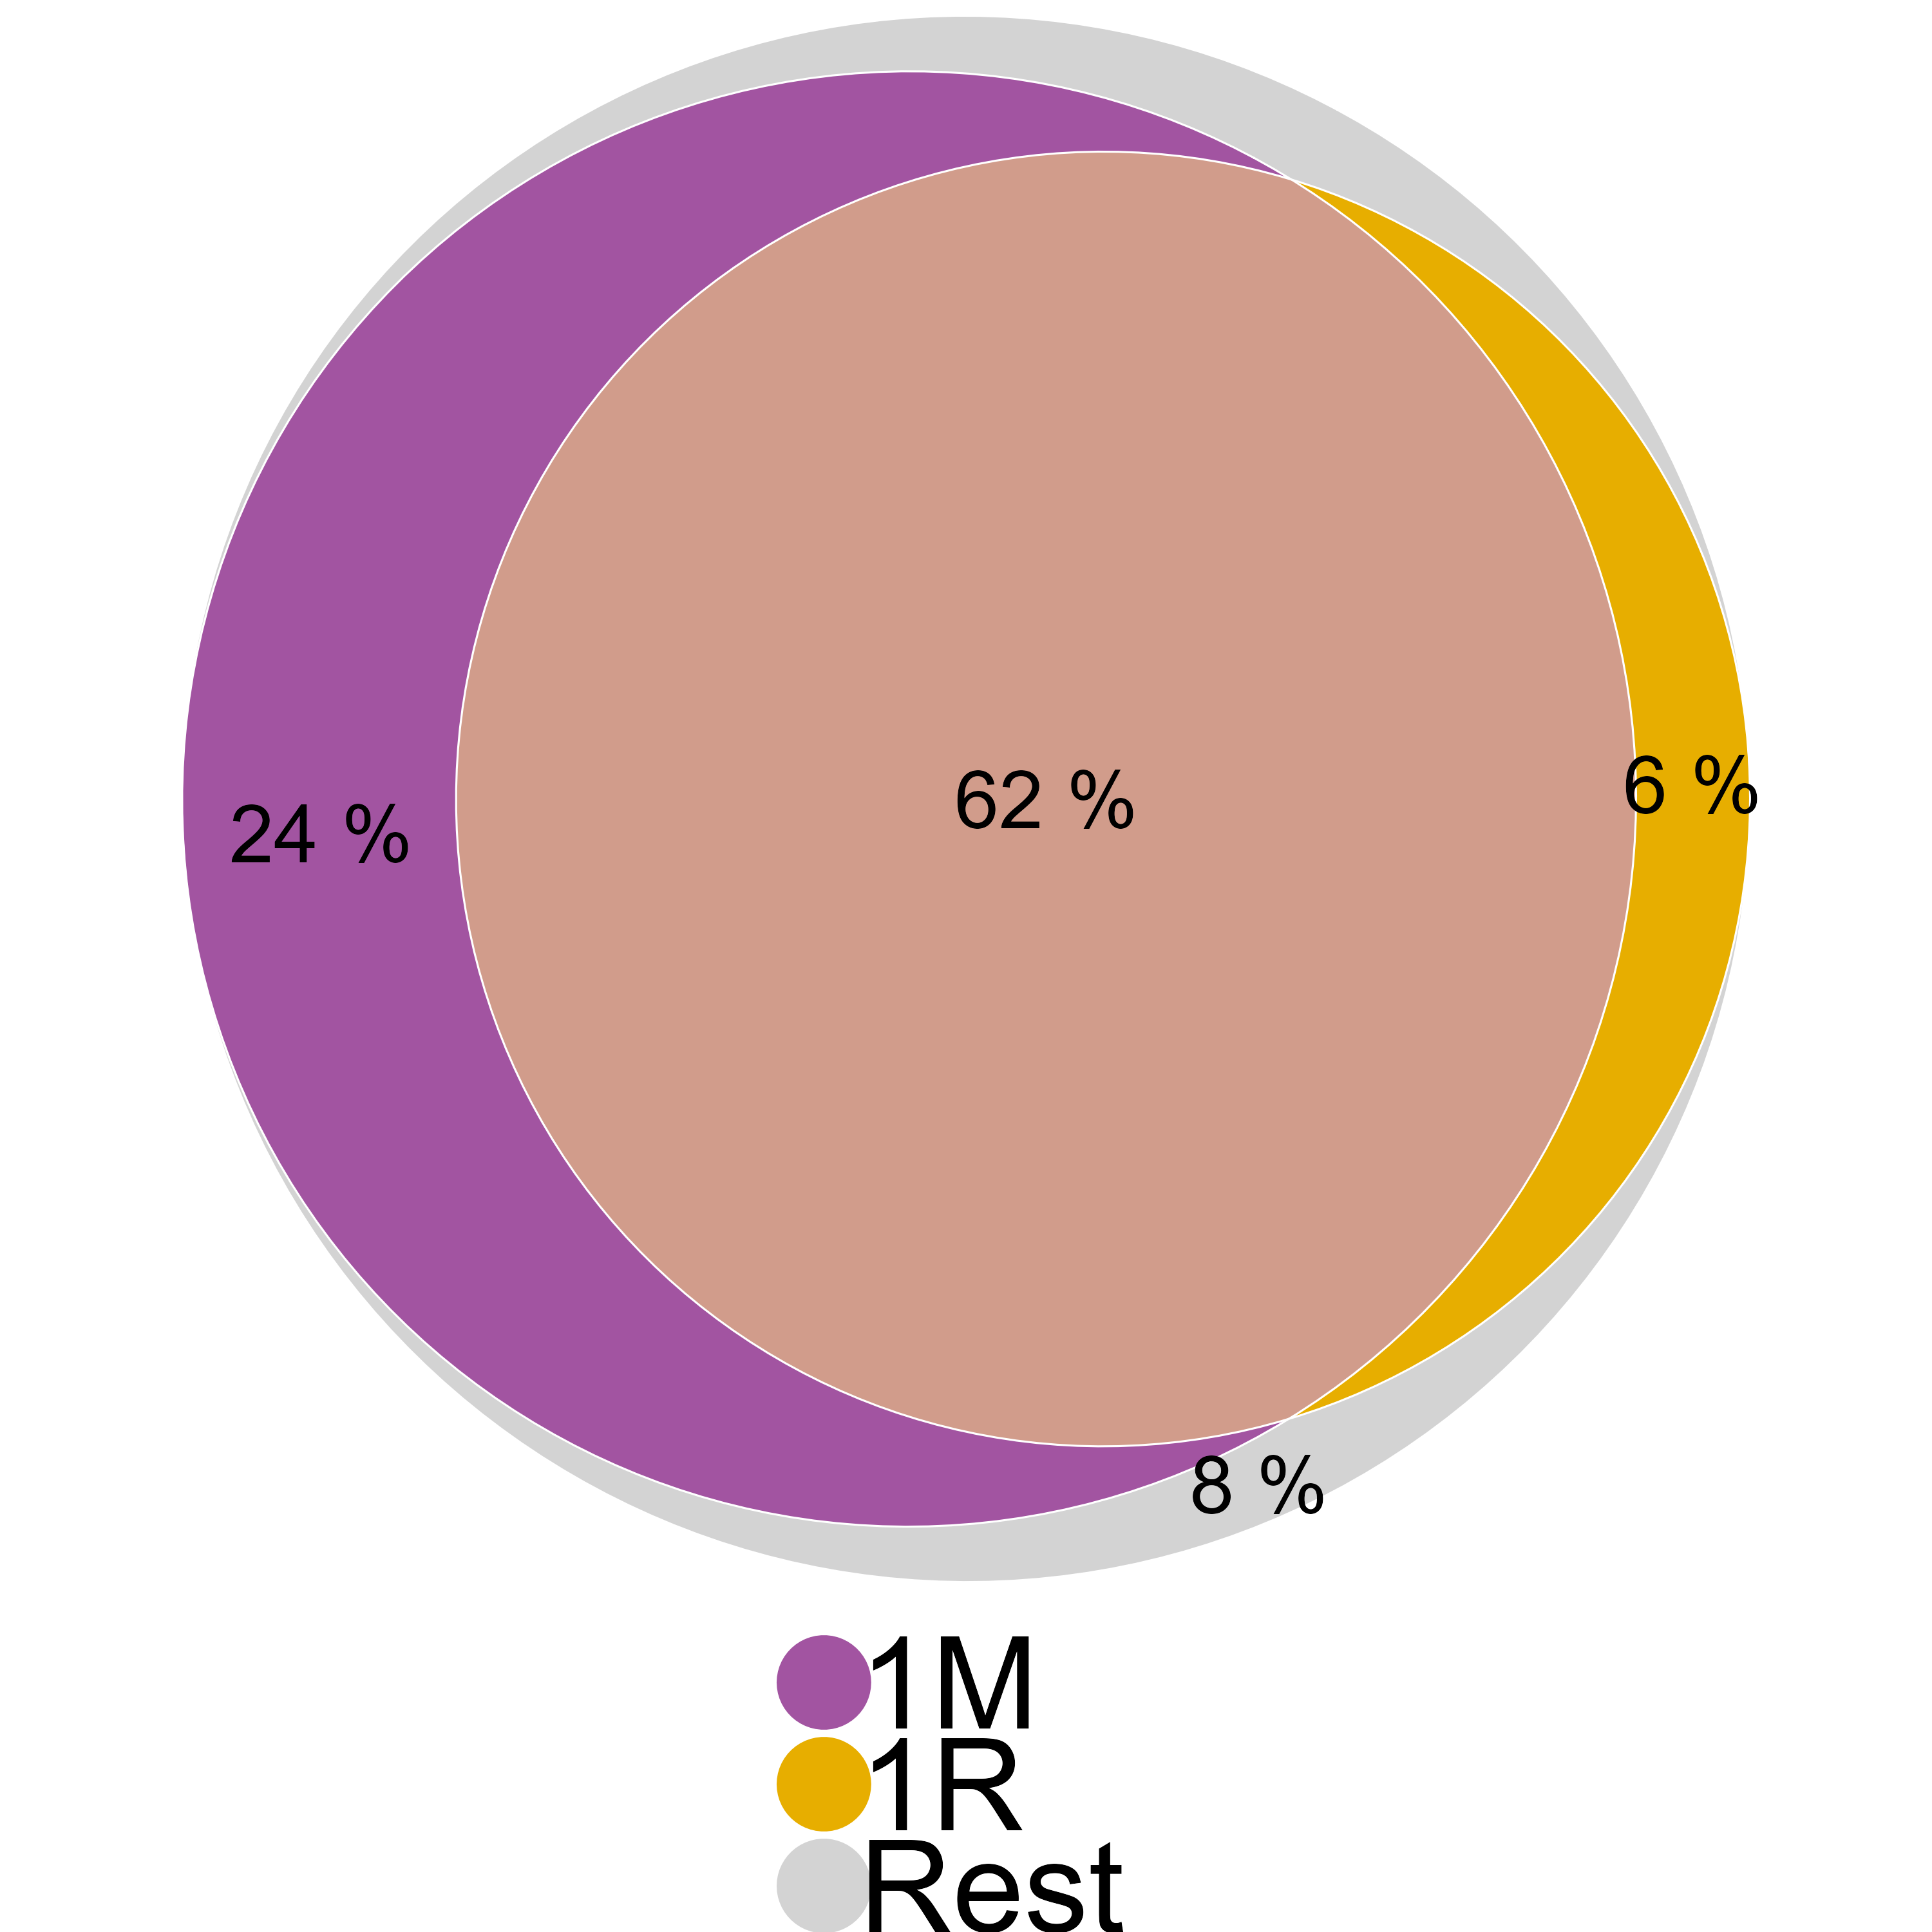
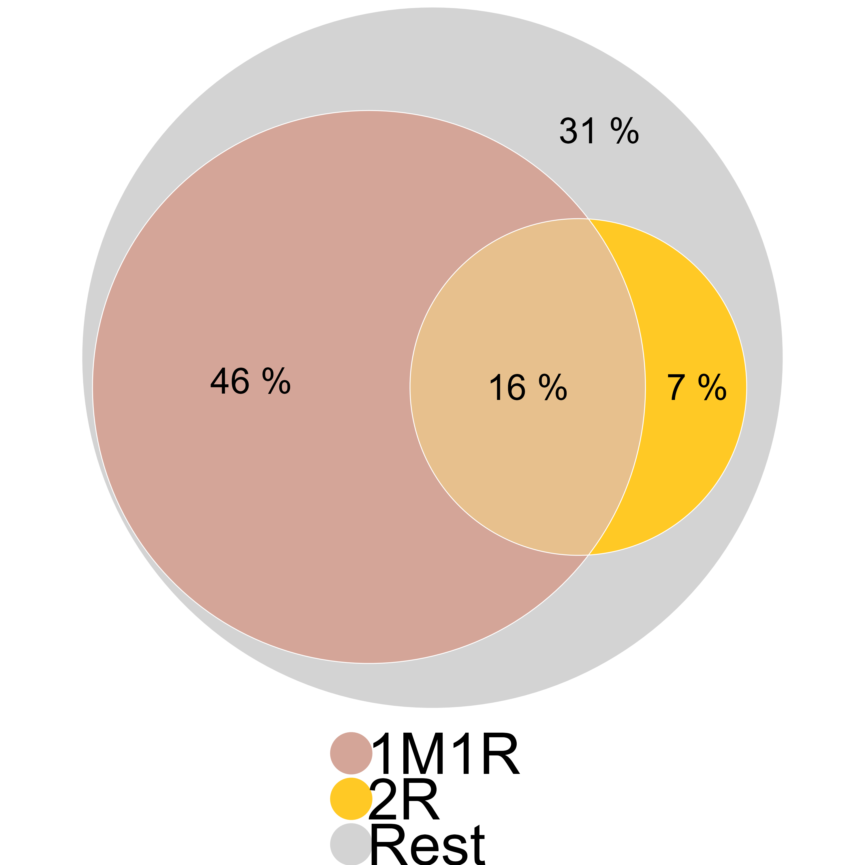
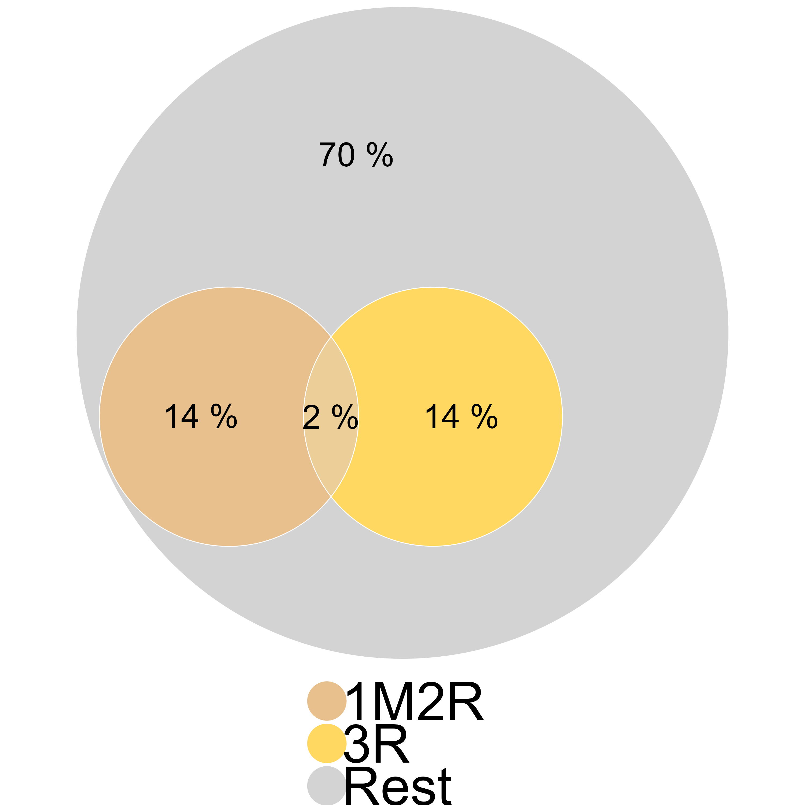
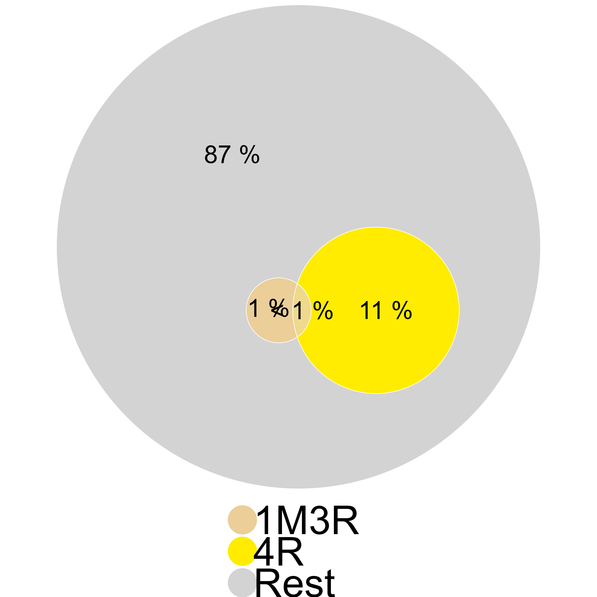
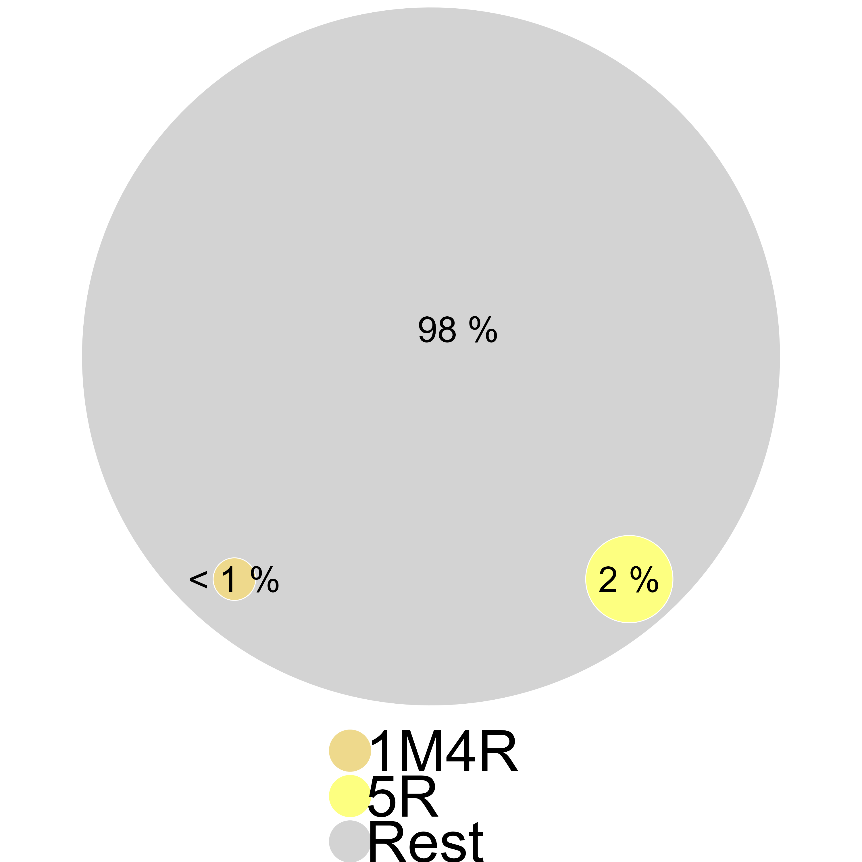
Adoption estimates from 2023 (lenient criteria)
1M1R2R3R4R
+ Post-harvest losses (5R)
Certified seeds (1M)
Certified seeds (1M) + Seed rate (1R)
1M1R
+ Nitrogen (2R)
1M1R2R
+ Pesticides (3R)
1M1R2R3R
+ AWD (4R)
86%
62%
16%
2%
<1%
0%
Notes:
Sujata
But in 2023 our set of questions is both more complete – in that it covers all domains -- and appropriately phrased to capture what farmers in fact do, with an eye on using that to evaluate whether they meet the recommendations or not.
We start with 86% hhs saying they used certified seeds and 68% saying they used less than the threshold seed rate (120 kg/ha), so that 62% followed both.
In Moon 1: 14% were not using certified seeds. In Moon 2: 8% were either not doing certified seeds AND were not doing seed rate.
However we can only say that 23% followed the nitrogen recommendation – because as you recall, some 17% could not recall the formula for their fertilizer, and others either did not meet the number of splits, or the quantity or the timing recommendation.
So the intersection set falls to 16% of farmers.
When we sequentially add in the other recommendations, the % of adopters falls quickly – so that when all 6 recommendations are considered, there were no hhs in the sample who could be said to have followed the 1M5R package.

Slide 45

Conclusion
A truly mixed methods approach to measure farmers’ actions, behaviors and practices.
Farmers had a sophisticated understanding of their farming practices; in many domains could readily answer questions that allowed measurement.
We had to grapple with principles underlying the recommendations and how they juxtapose against realities of rice cultivation.
Contingent recommendations required us to understand not just what farmers did, but what they would have done in a different state of the world. These counterfactuals did not easily lend to survey questions.
Notes:
Quantitative researchers commonly believe that qualitative adds texture/colour/rich narrative. But our research question and context led us to a truly mixed methods approach to measure adoption – a) to develop quant survey questions that could reliably capture what farmers do and b) to try and assess whether their actions could be attributed to the innovation. In the process we learned several lessons –
Before the qual work, we may have worried that it was too complicated to ask farmers about their practices, or that they did not have the numeracy skills to report seed rates, fertiliser formulae, etc. But farmers were in fact quite sophisticated, and the qual work clarified what questions we could ask, and in what domains, we could attempt attribution.
At the same time, we learned that every domain is different. To frame the questions, we had to grapple with the principles behind the recommendations, and how they fit into the realities of rice cultivation. Certain recommendations were straightforward to follow, and therefore straightforward to ask about. But other recommendations were contingent on the state of the world – e.g. to apply pesticide for prevention and not treatment – would have required us not just to examine what farmers had done, but also what they would have done if the state of the world had been different. It was not feasible to ask about such counterfactuals in a large scale survey.

